Slide 1
Module 3:
Quantum Fourier Transforms
Prof. Abhishek Dixit
Dept. of Electrical Engineering
IIT Delhi

Slide 2
Outline
General overview
Implementation of DFT
Quantum phase estimation

Slide 3
Quantum Fourier Transforms
So far, we have seen that quantum algorithms solve certain tasks in a much faster better
But we did not see any example of practically interesting task
QFT is a technique towards that.

Slide 4
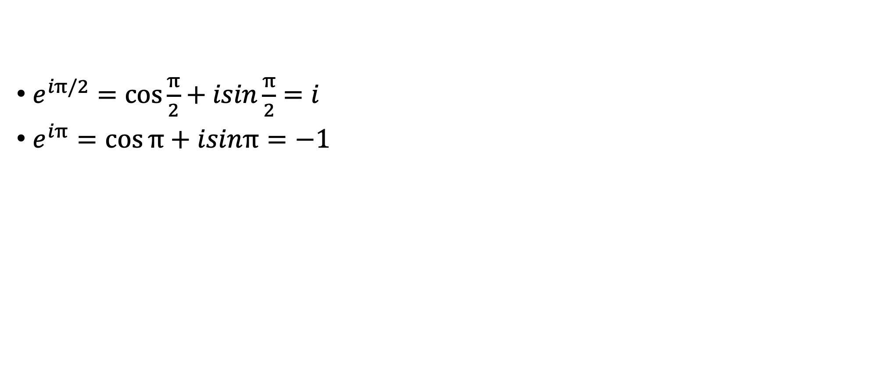
Revise complex exponentials
$e^{iπ/2}=\cos{\frac{π}{2}}+isin\frac{π}{2}=i$
$e^{iπ}=\cos{π}+isinπ=−1$

Slide 5
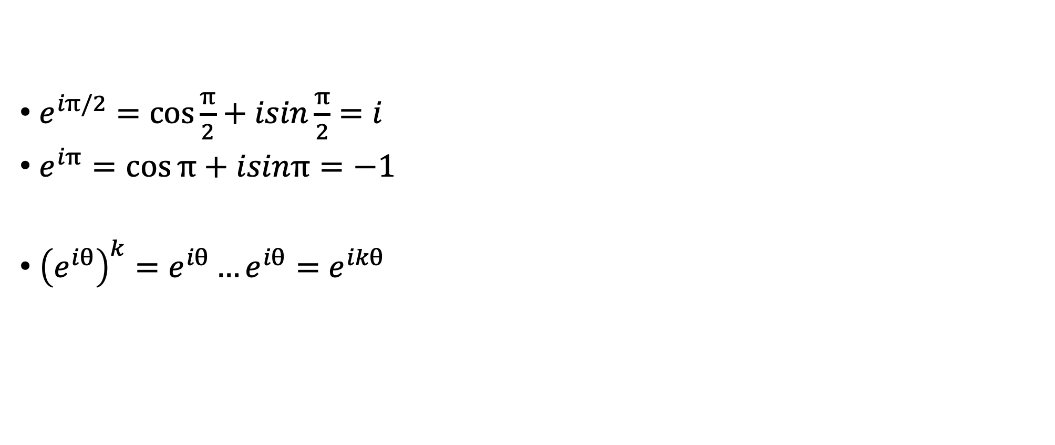
Revise complex exponentials
$e^{iπ/2}=\cos{\frac{π}{2}}+isin\frac{π}{2}=i$
$e^{iπ}=\cos{π}+isinπ=−1$
${\left(e^{iθ}\right)}^{k}=e^{iθ}…e^{iθ}=e^{ikθ}$

Slide 6
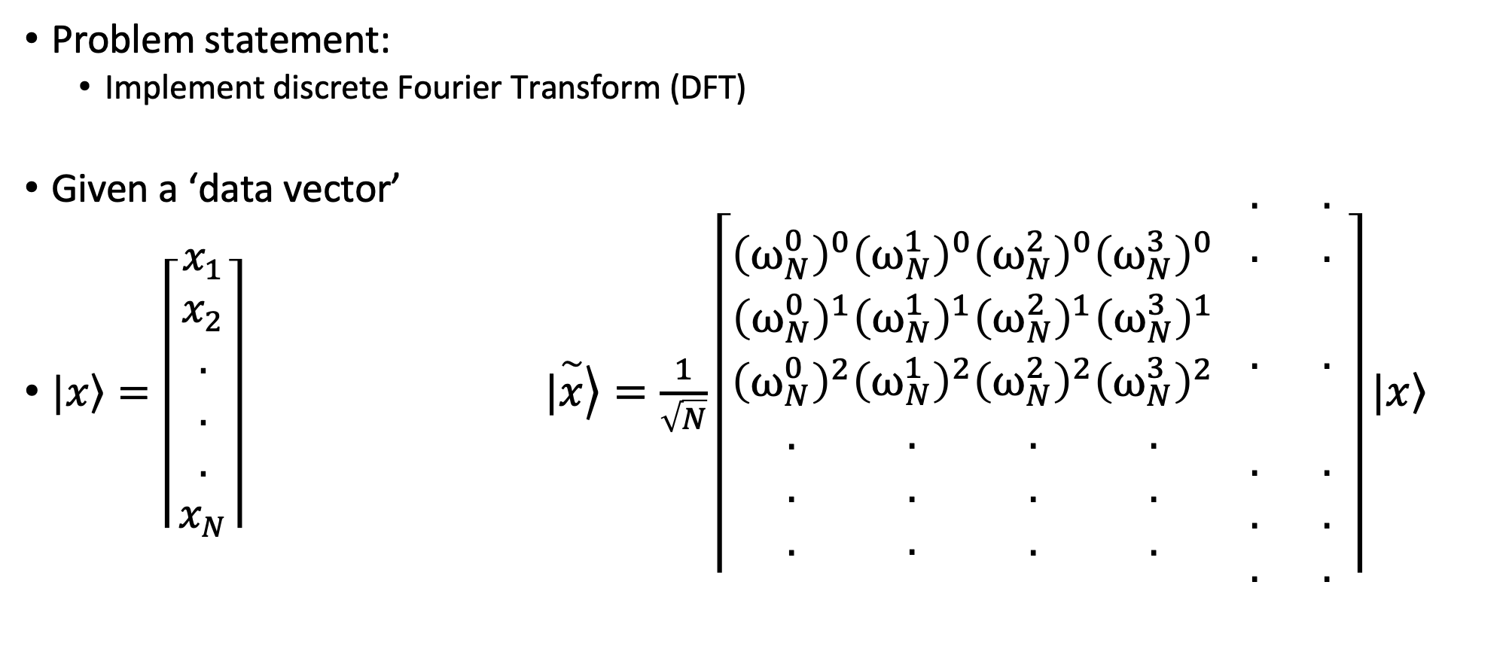
Quantum Fourier Transforms
Problem statement:
  Implement discrete Fourier Transform (DFT)
Given a ‘data vector’
$|\left.x\right\rangle =\left\lceil \begin{aligned}x_{1} \\ x_{2} \\ . \\ . \\ . \\ x_{N}\end{aligned}\right\rceil$ $|\left.\overset{\sim }{x}\right\rangle =\frac{1}{\sqrt{N}}\left\lceil \begin{aligned}{\left(ω_{N}^{0}\right)}^{0} \\ {\left(ω_{N}^{0}\right)}^{1} \\ {\left(ω_{N}^{0}\right)}^{2} \\ . \\ . \\ .\end{aligned}\begin{aligned}{\left(ω_{N}^{1}\right)}^{0} \\ {\left(ω_{N}^{1}\right)}^{1} \\ {\left(ω_{N}^{1}\right)}^{2} \\ . \\ . \\ .\end{aligned}\begin{aligned}{\left(ω_{N}^{2}\right)}^{0} \\ {\left(ω_{N}^{2}\right)}^{1} \\ {\left(ω_{N}^{2}\right)}^{2} \\ . \\ . \\ .\end{aligned}\begin{aligned}{\left(ω_{N}^{3}\right)}^{0} \\ {\left(ω_{N}^{3}\right)}^{1} \\ {\left(ω_{N}^{3}\right)}^{2} \\ . \\ . \\ .\end{aligned} \begin{aligned}. \\ . \\ \\ . \\ \\ . \\ . \\ .\end{aligned} \begin{aligned}. \\ . \\ \\ . \\ \\ . \\ . \\ .\end{aligned}\right\rceil |\left.x\right\rangle$
DFT

Slide 7
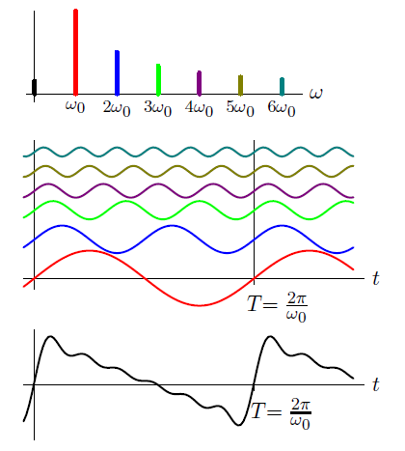
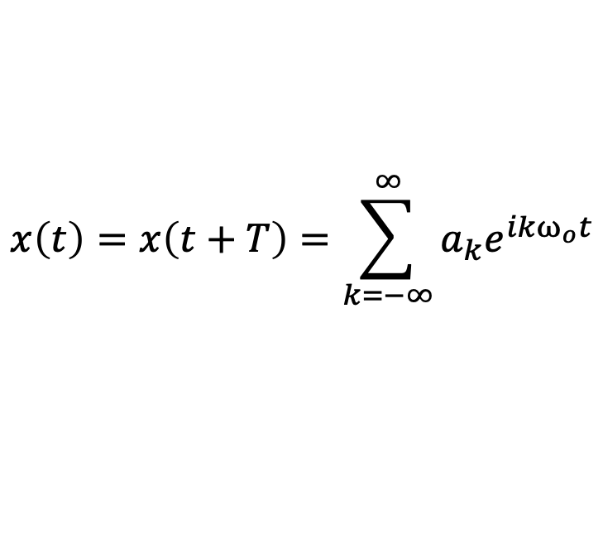
FT
Extremely important transform with broad applications, e.g., data compression, signal processing, scientific computing
$$x\left(t\right)=x\left(t+T\right)=\sum_{k=−∞}^{∞}{a_{k}e^{ikω_{o}t}}$$

Slide 8
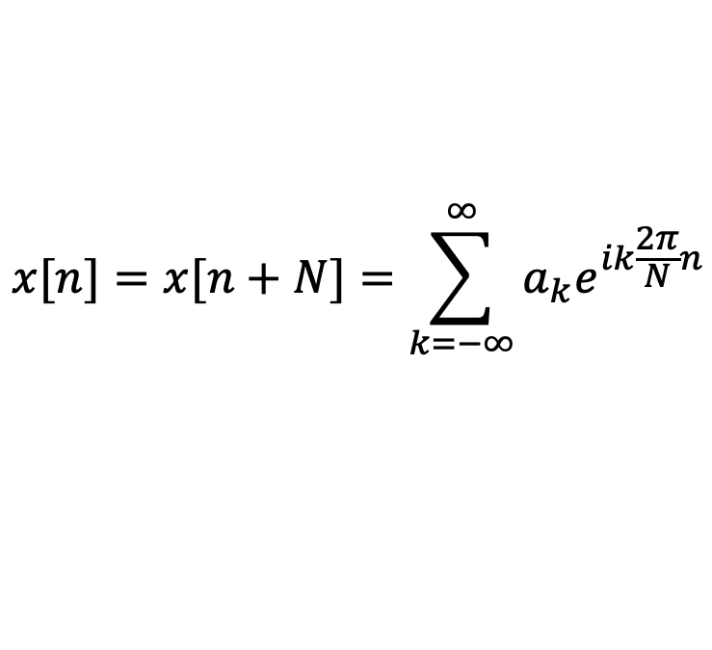
DFT
Extremely important transform with broad applications, e.g., data compression, signal processing, scientific computing
$$x[n]=x[n+N]=\sum_{k=−∞}^{∞}{a_{k}e^{ik\frac{2π}{N}n}}$$

Slide 9
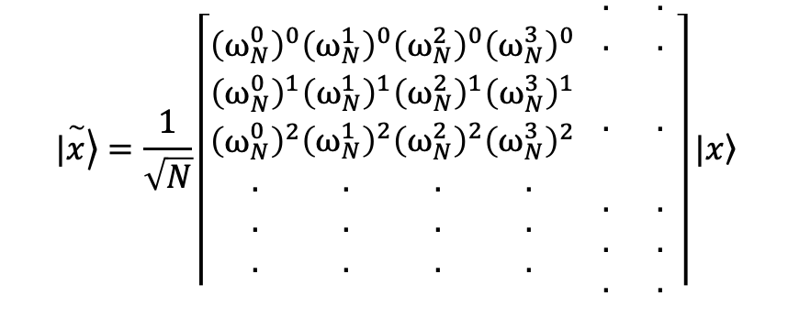
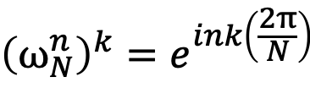
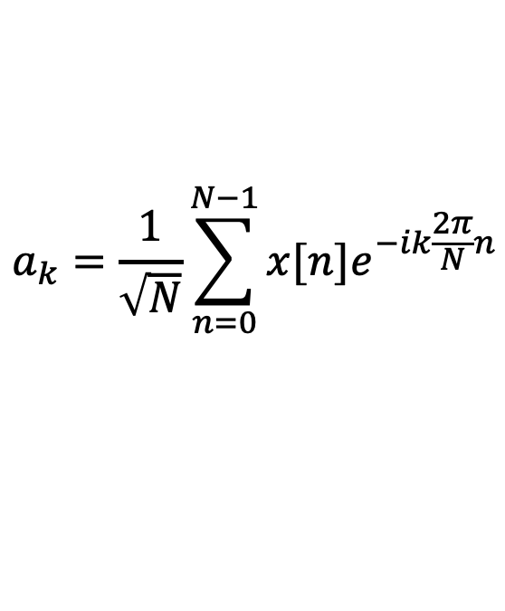
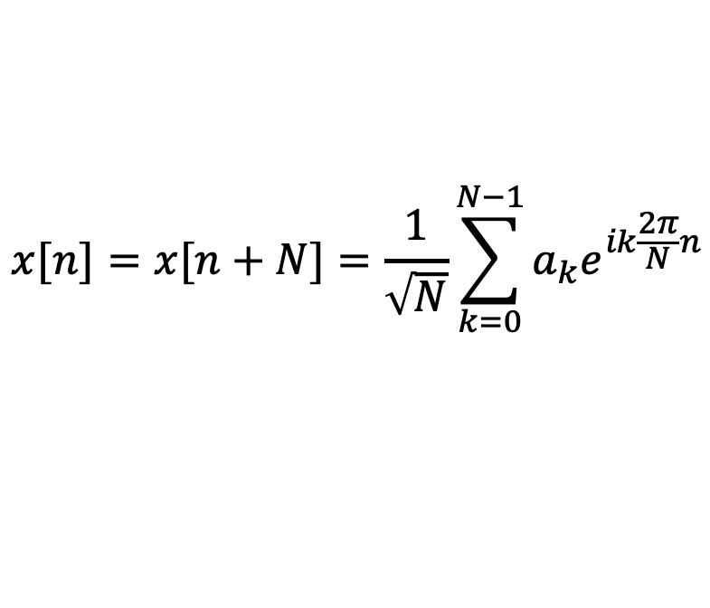
DFT
Extremely important transform with broad applications, e.g., data compression, signal processing, scientific computing
$${\left(ω_{N}^{n}\right)}^{k}=e^{ink\left(\frac{2π}{N}\right)}$$
$$|\left.\overset{\sim }{x}\right\rangle =\frac{1}{\sqrt{N}}\left\lceil \begin{aligned}{\left(ω_{N}^{0}\right)}^{0} \\ {\left(ω_{N}^{0}\right)}^{1} \\ {\left(ω_{N}^{0}\right)}^{2} \\ . \\ . \\ .\end{aligned}\begin{aligned}{\left(ω_{N}^{1}\right)}^{0} \\ {\left(ω_{N}^{1}\right)}^{1} \\ {\left(ω_{N}^{1}\right)}^{2} \\ . \\ . \\ .\end{aligned}\begin{aligned}{\left(ω_{N}^{2}\right)}^{0} \\ {\left(ω_{N}^{2}\right)}^{1} \\ {\left(ω_{N}^{2}\right)}^{2} \\ . \\ . \\ .\end{aligned}\begin{aligned}{\left(ω_{N}^{3}\right)}^{0} \\ {\left(ω_{N}^{3}\right)}^{1} \\ {\left(ω_{N}^{3}\right)}^{2} \\ . \\ . \\ .\end{aligned} \begin{aligned}. \\ . \\ \\ . \\ \\ . \\ . \\ .\end{aligned} \begin{aligned}. \\ . \\ \\ . \\ \\ . \\ . \\ .\end{aligned}\right\rceil |\left.x\right\rangle$$
$$x[n]=x[n+N]=\frac{1}{\sqrt{N}}\sum_{k=0}^{N−1}{a_{k}e^{ik\frac{2π}{N}n}}$$
$$a_{k}=\frac{1}{\sqrt{N}}\sum_{n=0}^{N−1}{x[n]e^{−ik\frac{2π}{N}n}}$$

Slide 10
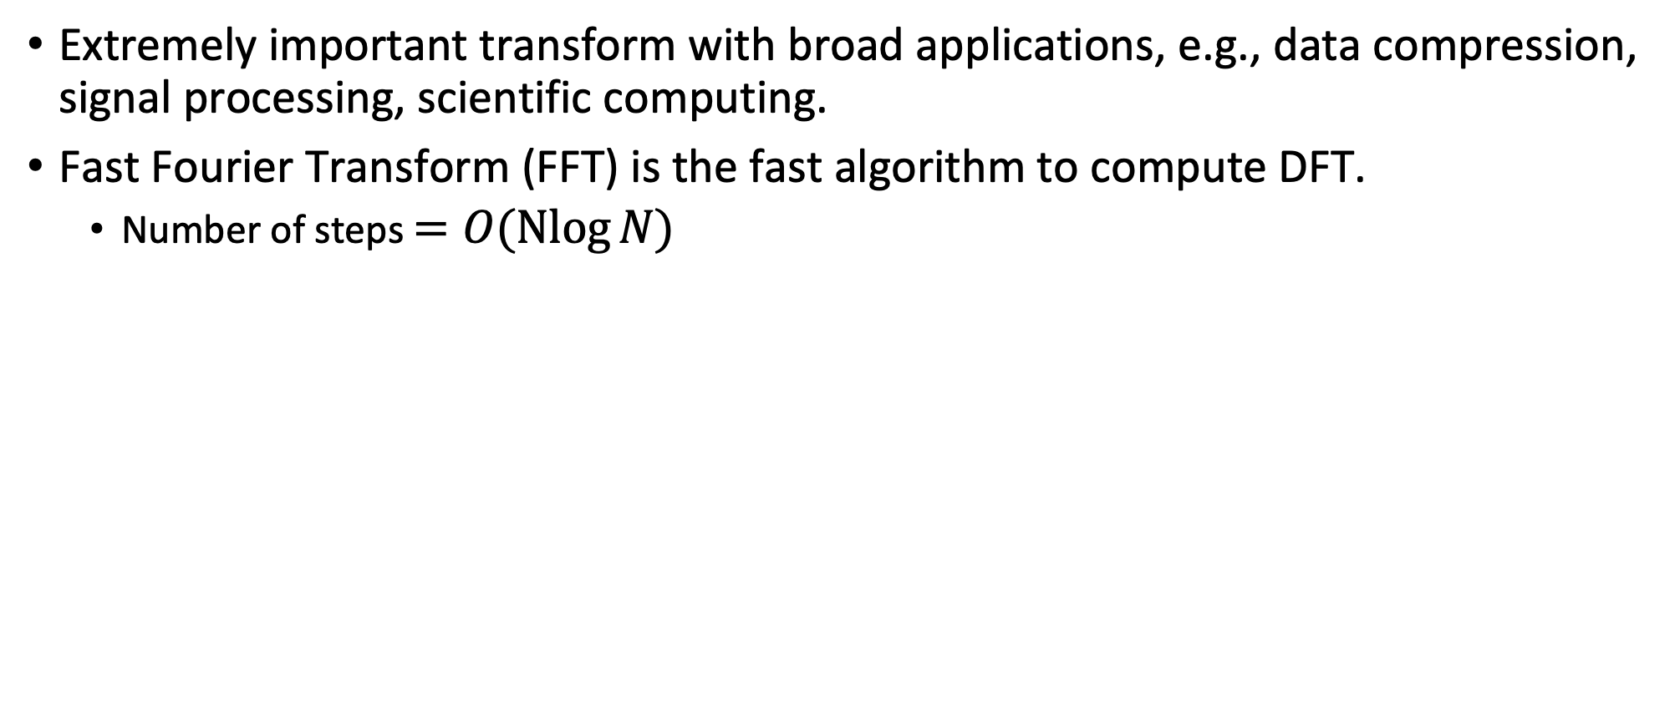
DFT
Extremely important transform with broad applications, e.g., data compression, signal processing, scientific computing.
Fast Fourier Transform (FFT) is the fast algorithm to compute DFT.
  Number of steps $=O(\operatorname{Nlog}{N)}$

Slide 11
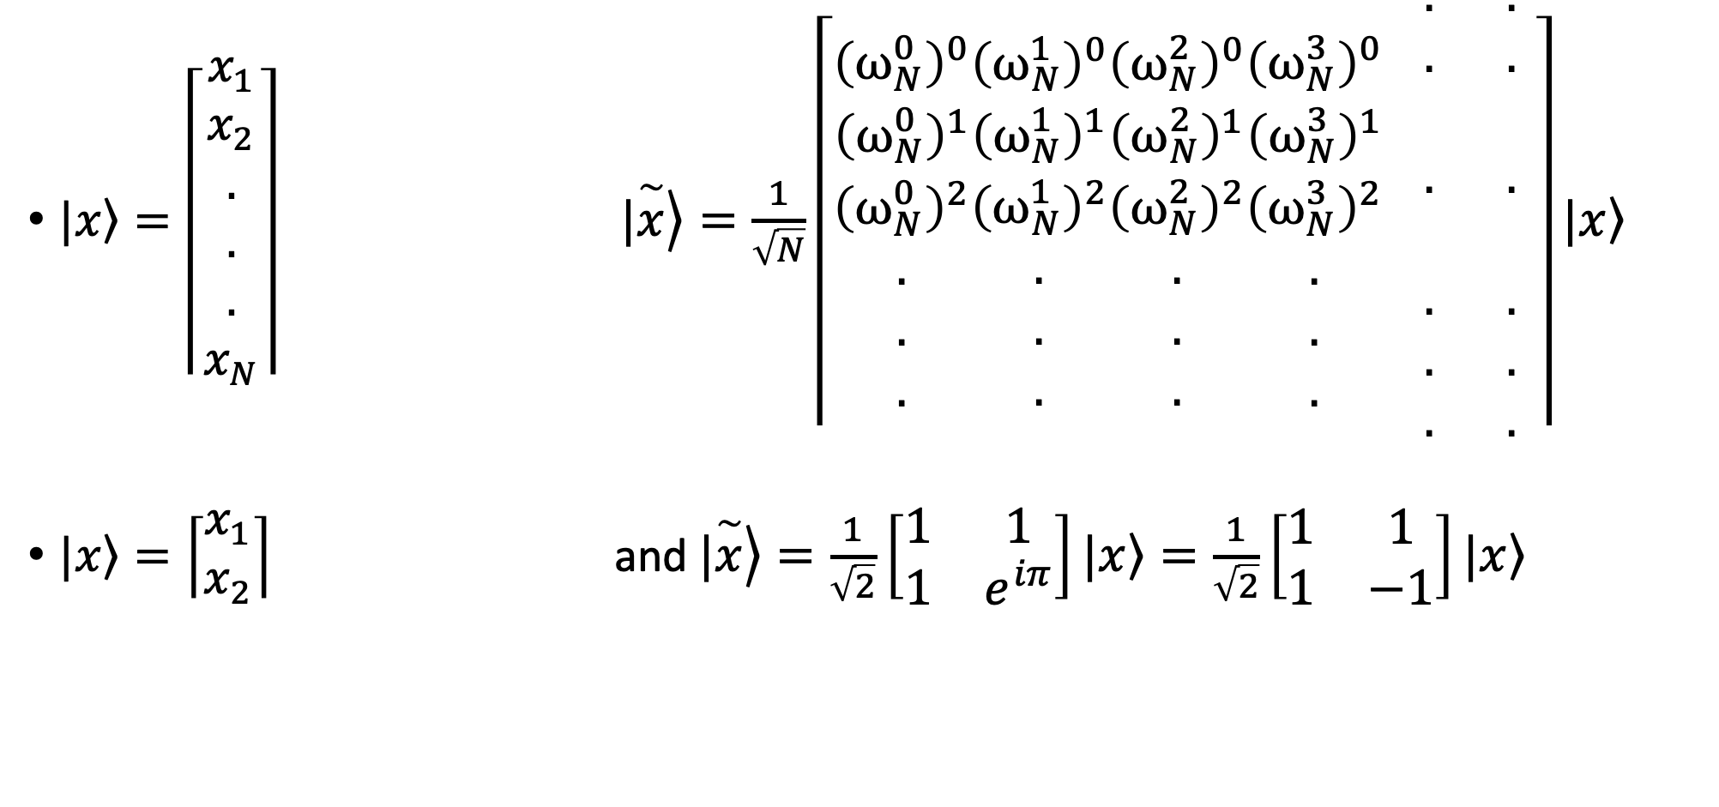
DFT on a single qubit
$|\left.x\right\rangle =\left\lceil \begin{aligned}x_{1} \\ x_{2} \\ . \\ . \\ . \\ x_{N}\end{aligned}\right\rceil$ $|\left.\overset{\sim }{x}\right\rangle =\frac{1}{\sqrt{N}}\left\lceil \begin{aligned}{\left(ω_{N}^{0}\right)}^{0} \\ {\left(ω_{N}^{0}\right)}^{1} \\ {\left(ω_{N}^{0}\right)}^{2} \\ . \\ . \\ .\end{aligned}\begin{aligned}{\left(ω_{N}^{1}\right)}^{0} \\ {\left(ω_{N}^{1}\right)}^{1} \\ {\left(ω_{N}^{1}\right)}^{2} \\ . \\ . \\ .\end{aligned}\begin{aligned}{\left(ω_{N}^{2}\right)}^{0} \\ {\left(ω_{N}^{2}\right)}^{1} \\ {\left(ω_{N}^{2}\right)}^{2} \\ . \\ . \\ .\end{aligned}\begin{aligned}{\left(ω_{N}^{3}\right)}^{0} \\ {\left(ω_{N}^{3}\right)}^{1} \\ {\left(ω_{N}^{3}\right)}^{2} \\ . \\ . \\ .\end{aligned} \begin{aligned}. \\ . \\ \\ . \\ \\ . \\ . \\ .\end{aligned} \begin{aligned}. \\ . \\ \\ . \\ \\ . \\ . \\ .\end{aligned}\right\rceil |\left.x\right\rangle$
$|\left.x\right\rangle =\left\lceil \begin{aligned}x_{1} \\ x_{2}\end{aligned}\right\rceil$ and $\left.|\overset{\sim }{x}\right\rangle =\frac{1}{\sqrt{2}}\left[\begin{matrix}1 & 1 \\ 1 & e^{iπ}\end{matrix}\right]\left.|x\right\rangle =\frac{1}{\sqrt{2}}\left[\begin{matrix}1 & 1 \\ 1 & −1\end{matrix}\right]\left.|x\right\rangle$

Slide 12
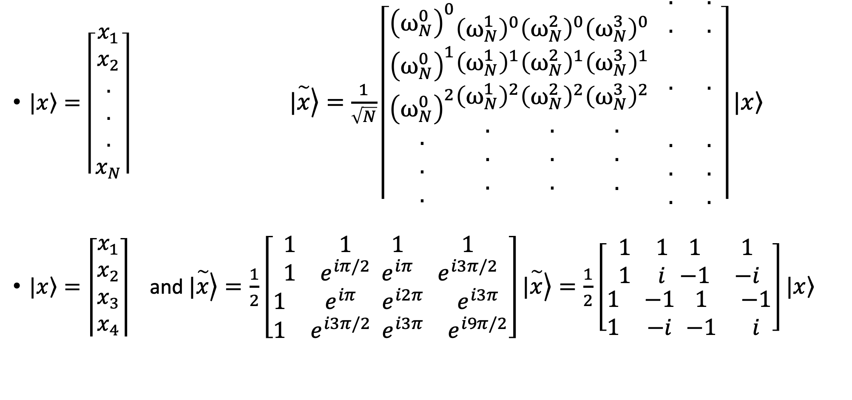
DFT on two qubits
$|\left.x\right\rangle =\left\lceil \begin{aligned}x_{1} \\ x_{2} \\ . \\ . \\ . \\ x_{N}\end{aligned}\right\rceil$ $|\left.\overset{\sim }{x}\right\rangle =\frac{1}{\sqrt{N}}\left\lceil \begin{aligned}{\left(ω_{N}^{0}\right)}^{0} \\ {\left(ω_{N}^{0}\right)}^{1} \\ {\left(ω_{N}^{0}\right)}^{2} \\ . \\ . \\ .\end{aligned}\begin{aligned}{\left(ω_{N}^{1}\right)}^{0} \\ {\left(ω_{N}^{1}\right)}^{1} \\ {\left(ω_{N}^{1}\right)}^{2} \\ . \\ . \\ .\end{aligned}\begin{aligned}{\left(ω_{N}^{2}\right)}^{0} \\ {\left(ω_{N}^{2}\right)}^{1} \\ {\left(ω_{N}^{2}\right)}^{2} \\ . \\ . \\ .\end{aligned}\begin{aligned}{\left(ω_{N}^{3}\right)}^{0} \\ {\left(ω_{N}^{3}\right)}^{1} \\ {\left(ω_{N}^{3}\right)}^{2} \\ . \\ . \\ .\end{aligned} \begin{aligned}. \\ . \\ \\ . \\ \\ . \\ . \\ .\end{aligned} \begin{aligned}. \\ . \\ \\ . \\ \\ . \\ . \\ .\end{aligned}\right\rceil |\left.x\right\rangle$
$|\left.x\right\rangle =\left\lceil \begin{aligned}x_{1} \\ x_{2} \\ x_{3} \\ x_{4}\end{aligned}\right\rceil$ and $\left.|\overset{\sim }{x}\right\rangle =\frac{1}{2}\left[\begin{aligned}\begin{matrix}1 & 1 \\ 1 & e^{iπ/2}\end{matrix} \begin{matrix}1 & 1 \\ e^{iπ} & e^{i3π/2}\end{matrix} \\ \begin{matrix}1 & e^{iπ} \\ 1 & e^{i3π/2}\end{matrix} \begin{matrix}e^{i2π} & e^{i3π} \\ e^{i3π} & e^{i9π/2}\end{matrix}\end{aligned}\right]\left.|\overset{\sim }{x}\right\rangle =\frac{1}{2}\left[\begin{aligned}\begin{matrix}1 & 1 \\ 1 & i\end{matrix} \begin{matrix}1 & 1 \\ −1 & −i\end{matrix} \\ \begin{matrix}1 & −1 \\ 1 & −i\end{matrix} \begin{matrix}1 & −1 \\ −1 & i\end{matrix}\end{aligned}\right]\left.|x\right\rangle$

Slide 13
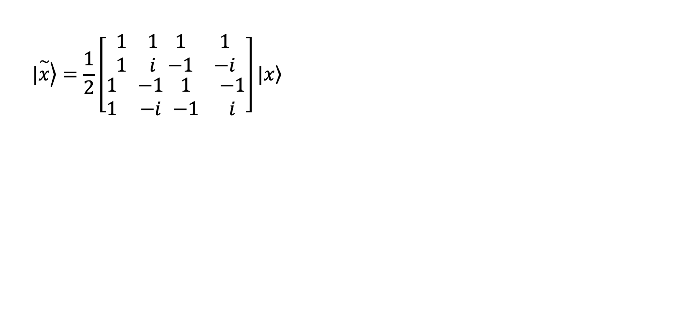
DFT on two qubits
$$|\left.\overset{\sim }{x}\right\rangle =\frac{1}{2}\left[\begin{aligned}\begin{matrix}1 & 1 \\ 1 & i\end{matrix} \begin{matrix}1 & 1 \\ −1 & −i\end{matrix} \\ \begin{matrix}1 & −1 \\ 1 & −i\end{matrix} \begin{matrix}1 & −1 \\ −1 & i\end{matrix}\end{aligned}\right]\left.|x\right\rangle$$

Slide 14
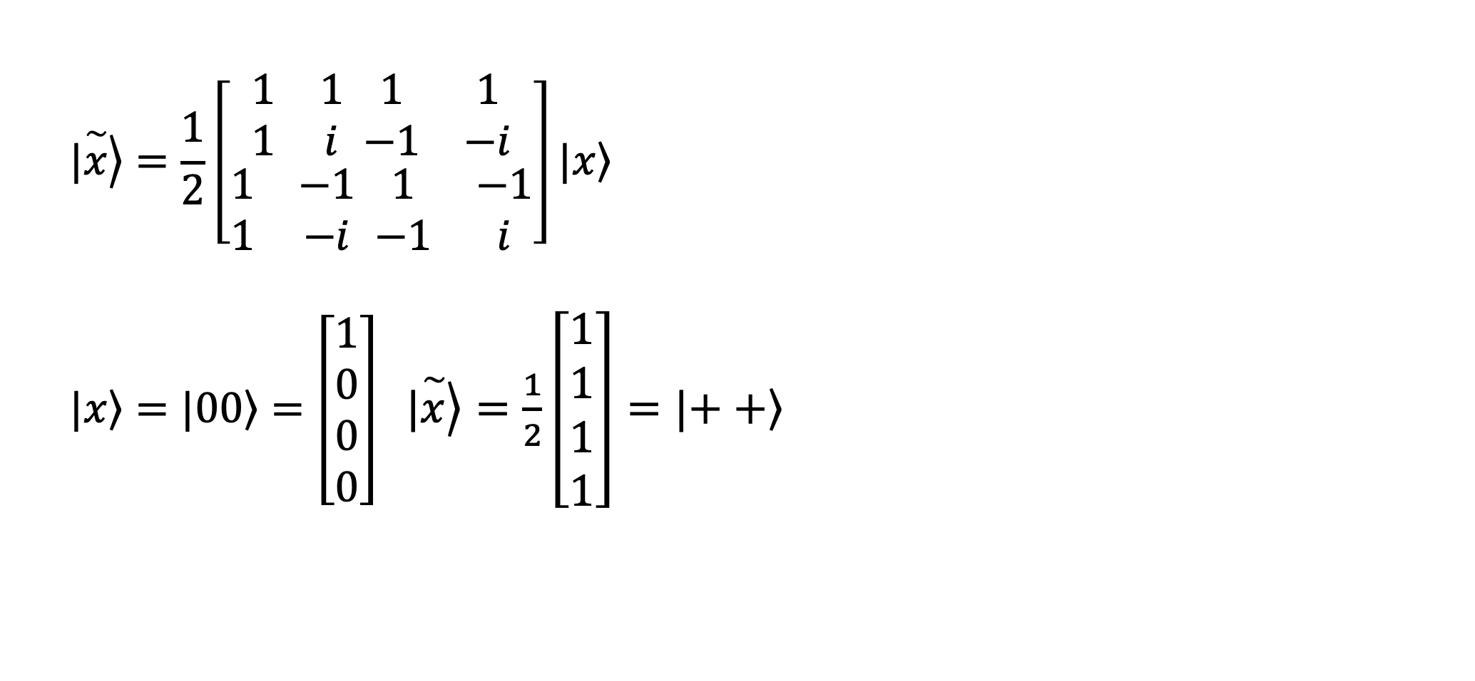
DFT on two qubits
$$|\left.\overset{\sim }{x}\right\rangle =\frac{1}{2}\left[\begin{aligned}\begin{matrix}1 & 1 \\ 1 & i\end{matrix} \begin{matrix}1 & 1 \\ −1 & −i\end{matrix} \\ \begin{matrix}1 & −1 \\ 1 & −i\end{matrix} \begin{matrix}1 & −1 \\ −1 & i\end{matrix}\end{aligned}\right]\left.|x\right\rangle$$
$\left.|x\right\rangle =|\left.00\right\rangle =\left[\begin{aligned}1 \\ 0 \\ 0 \\ 0\end{aligned}\right]$ $|\left.\overset{\sim }{x}\right\rangle =\frac{1}{2}\left[\begin{aligned}1 \\ 1 \\ 1 \\ 1\end{aligned}\right]=|\left.++\right\rangle$

Slide 15
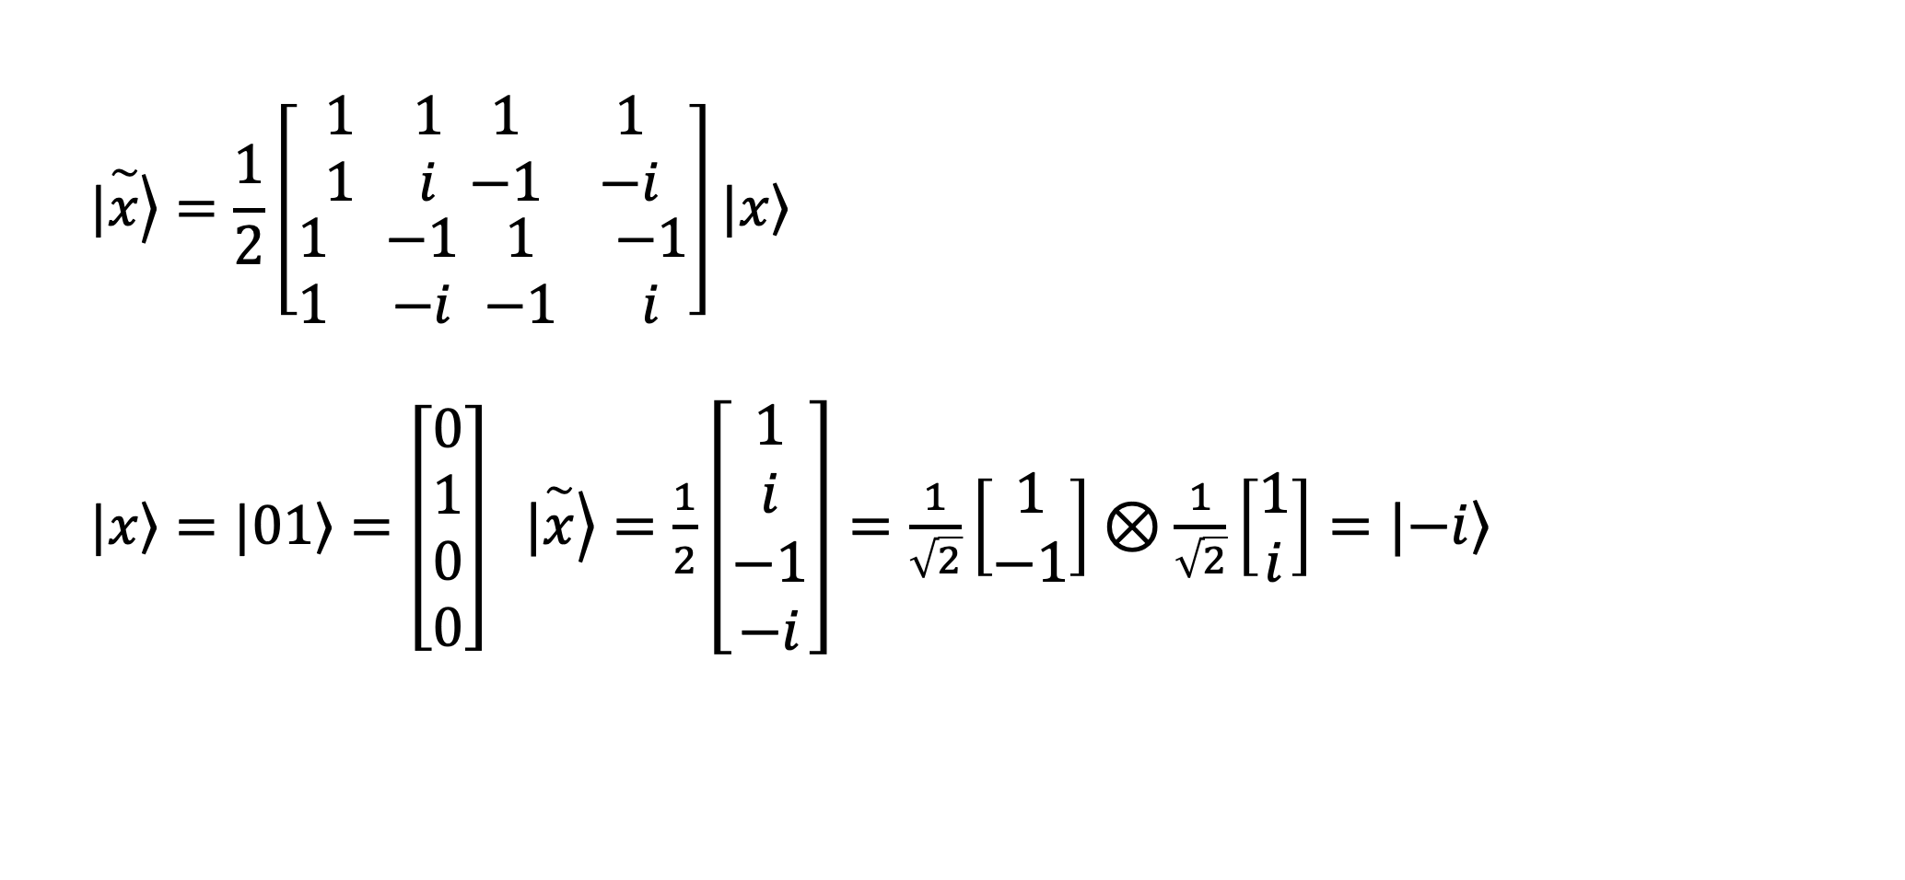
DFT on two qubits
$$|\left.\overset{\sim }{x}\right\rangle =\frac{1}{2}\left[\begin{aligned}\begin{matrix}1 & 1 \\ 1 & i\end{matrix} \begin{matrix}1 & 1 \\ −1 & −i\end{matrix} \\ \begin{matrix}1 & −1 \\ 1 & −i\end{matrix} \begin{matrix}1 & −1 \\ −1 & i\end{matrix}\end{aligned}\right]\left.|x\right\rangle$$
$\left.|x\right\rangle =|\left.01\right\rangle =\left[\begin{aligned}0 \\ 1 \\ 0 \\ 0\end{aligned}\right]$ $|\left.\overset{\sim }{x}\right\rangle =\frac{1}{2}\left[\begin{aligned}1 \\ i \\ −1 \\ −i\end{aligned}\right]=\frac{1}{\sqrt{2}}\left[\begin{aligned}1 \\ −1\end{aligned}\right]⊗\frac{1}{\sqrt{2}}\left[\begin{aligned}1 \\ i\end{aligned}\right]=|\left.−i\right\rangle$

Slide 16
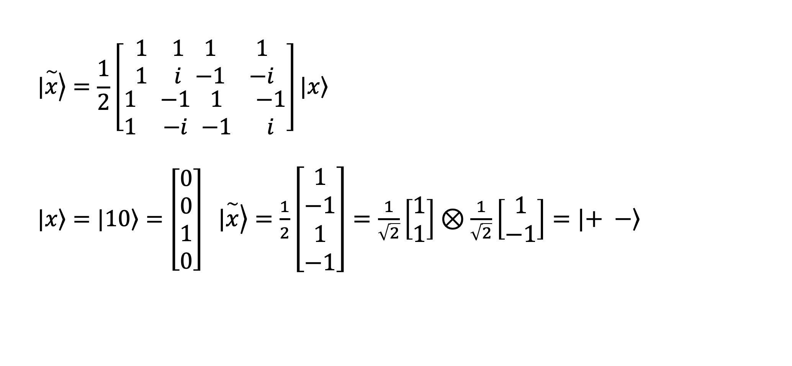
DFT on two qubits
$$|\left.\overset{\sim }{x}\right\rangle =\frac{1}{2}\left[\begin{aligned}\begin{matrix}1 & 1 \\ 1 & i\end{matrix} \begin{matrix}1 & 1 \\ −1 & −i\end{matrix} \\ \begin{matrix}1 & −1 \\ 1 & −i\end{matrix} \begin{matrix}1 & −1 \\ −1 & i\end{matrix}\end{aligned}\right]\left.|x\right\rangle$$
$\left.|x\right\rangle =|\left.10\right\rangle =\left[\begin{aligned}0 \\ 0 \\ 1 \\ 0\end{aligned}\right]$ $|\left.\overset{\sim }{x}\right\rangle =\frac{1}{2}\left[\begin{aligned}1 \\ −1 \\ 1 \\ −1\end{aligned}\right]=\frac{1}{\sqrt{2}}\left[\begin{aligned}1 \\ 1\end{aligned}\right]⊗\frac{1}{\sqrt{2}}\left[\begin{aligned}1 \\ −1\end{aligned}\right]=|\left.+ −\right\rangle$

Slide 17
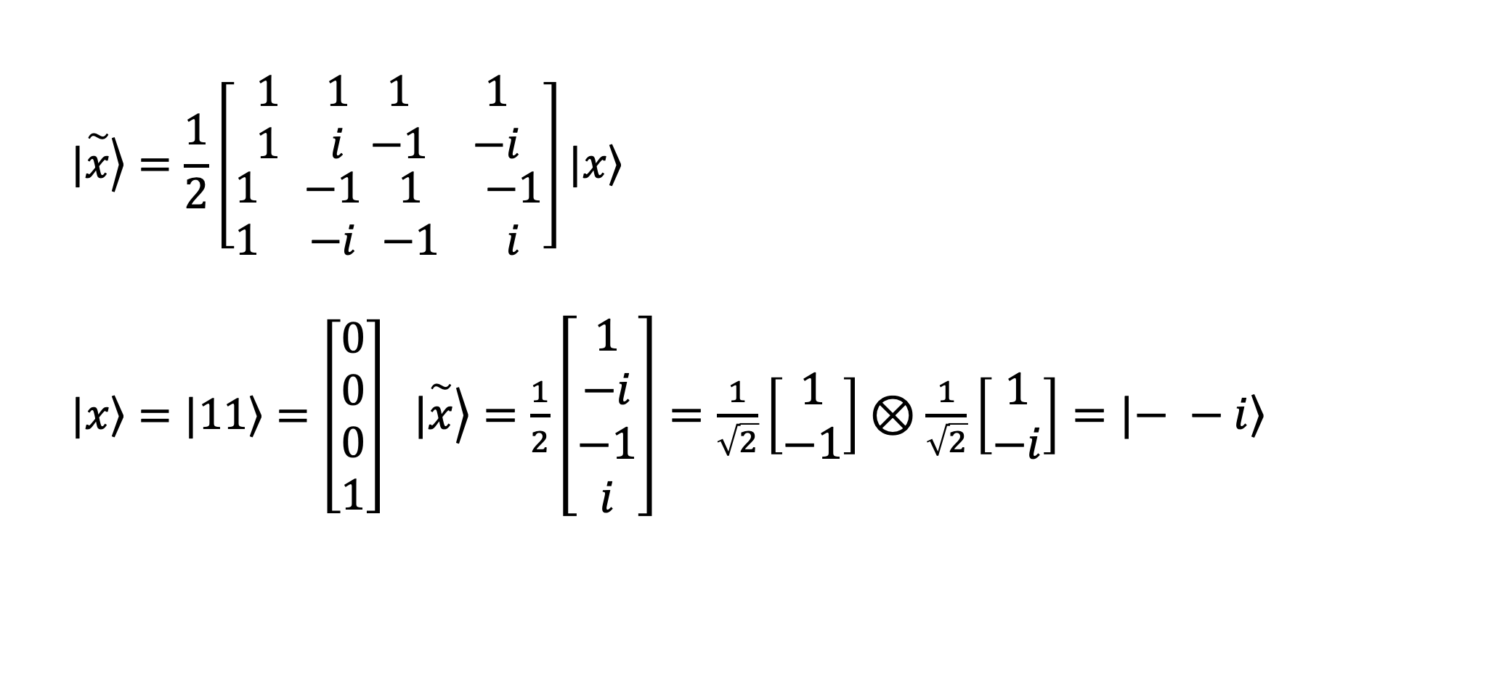
DFT on two qubits
$$|\left.\overset{\sim }{x}\right\rangle =\frac{1}{2}\left[\begin{aligned}\begin{matrix}1 & 1 \\ 1 & i\end{matrix} \begin{matrix}1 & 1 \\ −1 & −i\end{matrix} \\ \begin{matrix}1 & −1 \\ 1 & −i\end{matrix} \begin{matrix}1 & −1 \\ −1 & i\end{matrix}\end{aligned}\right]\left.|x\right\rangle$$
$\left.|x\right\rangle =|\left.11\right\rangle =\left[\begin{aligned}0 \\ 0 \\ 0 \\ 1\end{aligned}\right]$ $|\left.\overset{\sim }{x}\right\rangle =\frac{1}{2}\left[\begin{aligned}1 \\ −i \\ −1 \\ i\end{aligned}\right]=\frac{1}{\sqrt{2}}\left[\begin{aligned}1 \\ −1\end{aligned}\right]⊗\frac{1}{\sqrt{2}}\left[\begin{aligned}1 \\ −i\end{aligned}\right]=|\left.− −i\right\rangle$

Slide 18












































DFT on two qubits
$$\overset{^}{z}$$
$$\overset{^}{z}$$
$$\overset{^}{z}$$
$$\overset{^}{z}$$
$$\overset{^}{z}$$
$$\overset{^}{z}$$
$$\overset{^}{z}$$
$$\overset{^}{z}$$
$$\overset{^}{y}$$
$$\overset{^}{y}$$
$$\overset{^}{y}$$
$$\overset{^}{y}$$
$$\overset{^}{y}$$
$$\overset{^}{y}$$
$$\overset{^}{y}$$
$$\overset{^}{y}$$
$$\overset{^}{x}$$
$$\overset{^}{x}$$
$$\overset{^}{x}$$
$$\overset{^}{x}$$
$$\overset{^}{x}$$
$$\overset{^}{x}$$
$$\overset{^}{x}$$
$$\overset{^}{x}$$
$$−\overset{^}{z}$$
$$−\overset{^}{z}$$
$$−\overset{^}{z}$$
$$−\overset{^}{z}$$
$$−\overset{^}{z}$$
$$−\overset{^}{z}$$
$$−\overset{^}{z}$$
$$−\overset{^}{z}$$
$$\overset{^}{z}$$
$$\overset{^}{z}$$
$$\overset{^}{z}$$
$$\overset{^}{z}$$
$$\overset{^}{z}$$
$$\overset{^}{z}$$
$$\overset{^}{z}$$
$$\overset{^}{z}$$
$$\overset{^}{y}$$
$$\overset{^}{y}$$
$$\overset{^}{y}$$
$$\overset{^}{y}$$
$$\overset{^}{y}$$
$$\overset{^}{y}$$
$$\overset{^}{y}$$
$$\overset{^}{y}$$
$$\overset{^}{x}$$
$$\overset{^}{x}$$
$$\overset{^}{x}$$
$$\overset{^}{x}$$
$$\overset{^}{x}$$
$$\overset{^}{x}$$
$$\overset{^}{x}$$
$$\overset{^}{x}$$
$$−\overset{^}{z}$$
$$−\overset{^}{z}$$
$$−\overset{^}{z}$$
$$−\overset{^}{z}$$
$$−\overset{^}{z}$$
$$−\overset{^}{z}$$
$$−\overset{^}{z}$$
$$−\overset{^}{z}$$

Slide 19
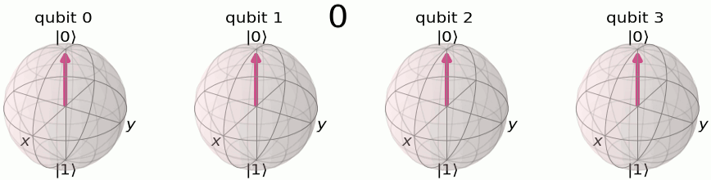
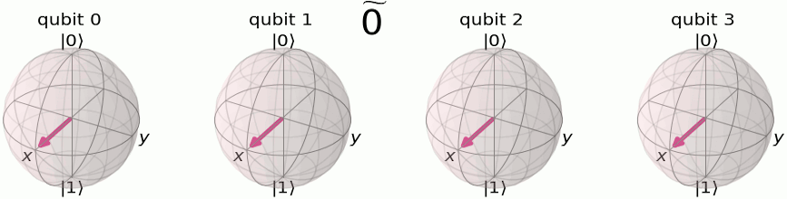
DFT
Z basis
F basis
Reference: Qiskit

Slide 20
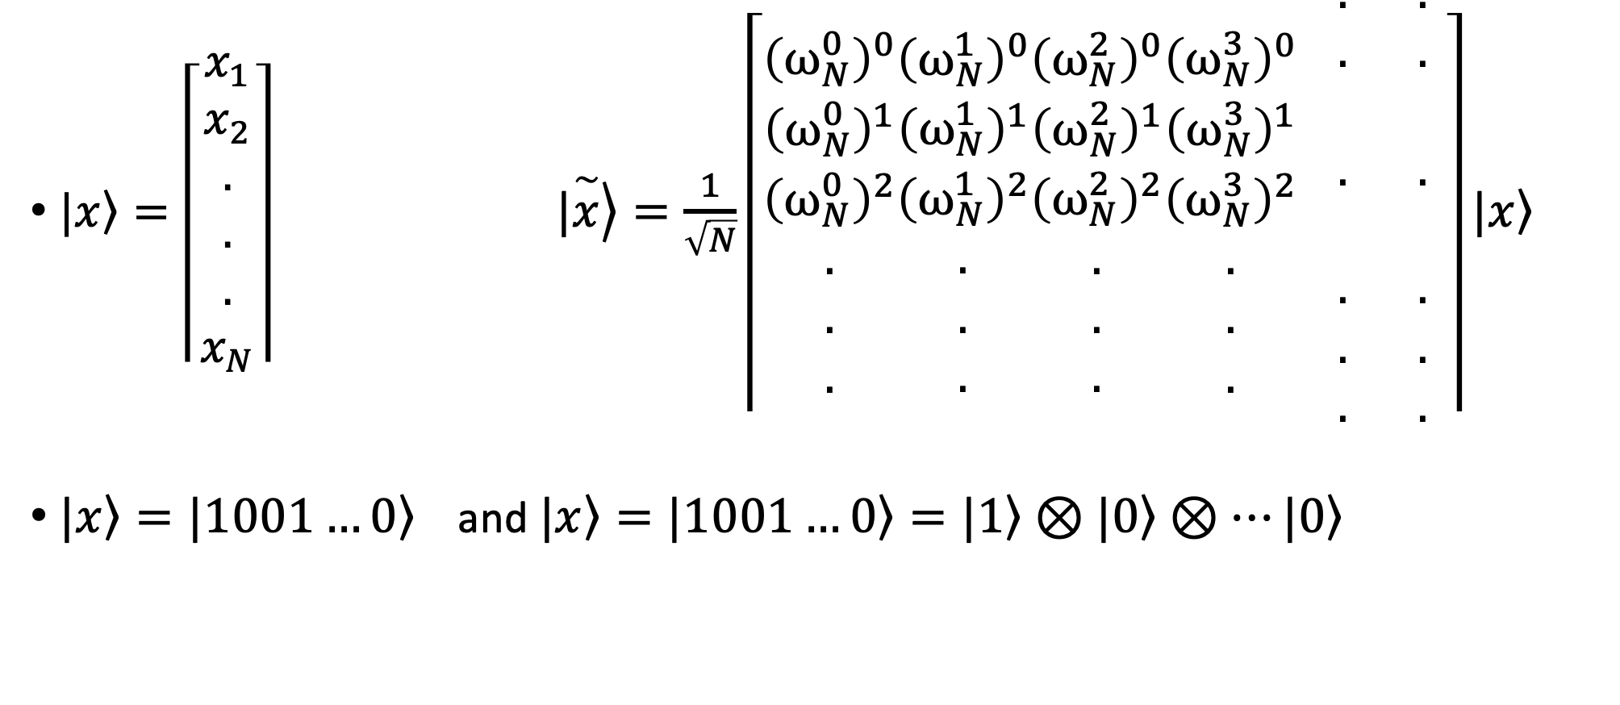


DFT on $n$ qubits
$|\left.x\right\rangle =\left\lceil \begin{aligned}x_{1} \\ x_{2} \\ . \\ . \\ . \\ x_{N}\end{aligned}\right\rceil$ $|\left.\overset{\sim }{x}\right\rangle =\frac{1}{\sqrt{N}}\left\lceil \begin{aligned}{\left(ω_{N}^{0}\right)}^{0} \\ {\left(ω_{N}^{0}\right)}^{1} \\ {\left(ω_{N}^{0}\right)}^{2} \\ . \\ . \\ .\end{aligned}\begin{aligned}{\left(ω_{N}^{1}\right)}^{0} \\ {\left(ω_{N}^{1}\right)}^{1} \\ {\left(ω_{N}^{1}\right)}^{2} \\ . \\ . \\ .\end{aligned}\begin{aligned}{\left(ω_{N}^{2}\right)}^{0} \\ {\left(ω_{N}^{2}\right)}^{1} \\ {\left(ω_{N}^{2}\right)}^{2} \\ . \\ . \\ .\end{aligned}\begin{aligned}{\left(ω_{N}^{3}\right)}^{0} \\ {\left(ω_{N}^{3}\right)}^{1} \\ {\left(ω_{N}^{3}\right)}^{2} \\ . \\ . \\ .\end{aligned} \begin{aligned}. \\ . \\ \\ . \\ \\ . \\ . \\ .\end{aligned} \begin{aligned}. \\ . \\ \\ . \\ \\ . \\ . \\ .\end{aligned}\right\rceil |\left.x\right\rangle$
$|\left.x\right\rangle =|\left.1001…0\right\rangle$ and $|\left.x\right\rangle =|\left.1001…0\right\rangle =|\left.1\right\rangle ⊗|\left.0\right\rangle ⊗…|\left.0\right\rangle$
$$n$$
$$2^{n}=N$$

Slide 21
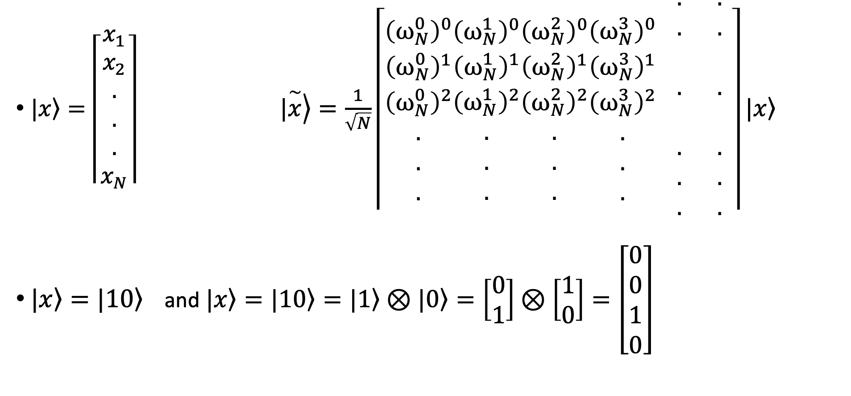
DFT on $n$ qubits
$|\left.x\right\rangle =\left\lceil \begin{aligned}x_{1} \\ x_{2} \\ . \\ . \\ . \\ x_{N}\end{aligned}\right\rceil$ $|\left.\overset{\sim }{x}\right\rangle =\frac{1}{\sqrt{N}}\left\lceil \begin{aligned}{\left(ω_{N}^{0}\right)}^{0} \\ {\left(ω_{N}^{0}\right)}^{1} \\ {\left(ω_{N}^{0}\right)}^{2} \\ . \\ . \\ .\end{aligned}\begin{aligned}{\left(ω_{N}^{1}\right)}^{0} \\ {\left(ω_{N}^{1}\right)}^{1} \\ {\left(ω_{N}^{1}\right)}^{2} \\ . \\ . \\ .\end{aligned}\begin{aligned}{\left(ω_{N}^{2}\right)}^{0} \\ {\left(ω_{N}^{2}\right)}^{1} \\ {\left(ω_{N}^{2}\right)}^{2} \\ . \\ . \\ .\end{aligned}\begin{aligned}{\left(ω_{N}^{3}\right)}^{0} \\ {\left(ω_{N}^{3}\right)}^{1} \\ {\left(ω_{N}^{3}\right)}^{2} \\ . \\ . \\ .\end{aligned} \begin{aligned}. \\ . \\ \\ . \\ \\ . \\ . \\ .\end{aligned} \begin{aligned}. \\ . \\ \\ . \\ \\ . \\ . \\ .\end{aligned}\right\rceil |\left.x\right\rangle$
$|\left.x\right\rangle =|\left.10\right\rangle$ and $|\left.x\right\rangle =|\left.10\right\rangle =|\left.1\right\rangle ⊗|\left.0\right\rangle =\left[\begin{aligned}0 \\ 1\end{aligned}\right]⊗\left[\begin{aligned}1 \\ 0\end{aligned}\right]=\left[\begin{aligned}0 \\ 0 \\ 1 \\ 0\end{aligned}\right]$

Slide 22
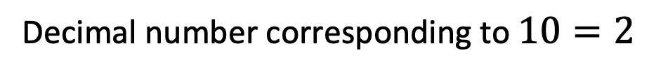
DFT on $n$ qubits
$|\left.x\right\rangle =\left\lceil \begin{aligned}x_{1} \\ x_{2} \\ . \\ . \\ . \\ x_{N}\end{aligned}\right\rceil$ $|\left.\overset{\sim }{x}\right\rangle =\frac{1}{\sqrt{N}}\left\lceil \begin{aligned}{\left(ω_{N}^{0}\right)}^{0} \\ {\left(ω_{N}^{0}\right)}^{1} \\ {\left(ω_{N}^{0}\right)}^{2} \\ . \\ . \\ .\end{aligned}\begin{aligned}{\left(ω_{N}^{1}\right)}^{0} \\ {\left(ω_{N}^{1}\right)}^{1} \\ {\left(ω_{N}^{1}\right)}^{2} \\ . \\ . \\ .\end{aligned}\begin{aligned}{\left(ω_{N}^{2}\right)}^{0} \\ {\left(ω_{N}^{2}\right)}^{1} \\ {\left(ω_{N}^{2}\right)}^{2} \\ . \\ . \\ .\end{aligned}\begin{aligned}{\left(ω_{N}^{3}\right)}^{0} \\ {\left(ω_{N}^{3}\right)}^{1} \\ {\left(ω_{N}^{3}\right)}^{2} \\ . \\ . \\ .\end{aligned} \begin{aligned}. \\ . \\ \\ . \\ \\ . \\ . \\ .\end{aligned} \begin{aligned}. \\ . \\ \\ . \\ \\ . \\ . \\ .\end{aligned}\right\rceil |\left.x\right\rangle$
$|\left.x\right\rangle =|\left.10\right\rangle$ and $|\left.x\right\rangle =|\left.10\right\rangle =|\left.1\right\rangle ⊗|\left.0\right\rangle =\left[\begin{aligned}0 \\ 1\end{aligned}\right]⊗\left[\begin{aligned}1 \\ 0\end{aligned}\right]=\left[\begin{aligned}0 \\ 0 \\ 1 \\ 0\end{aligned}\right]$
0
1
2
3
Decimal number corresponding to $10=2$

Slide 23
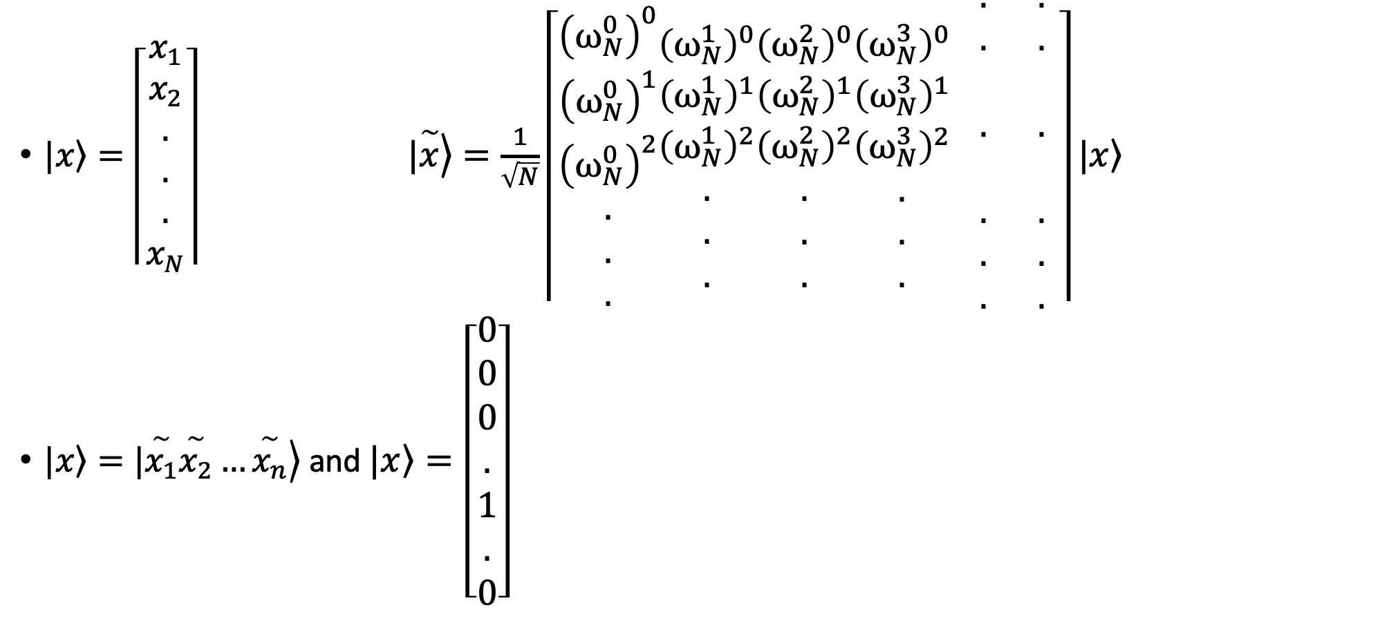
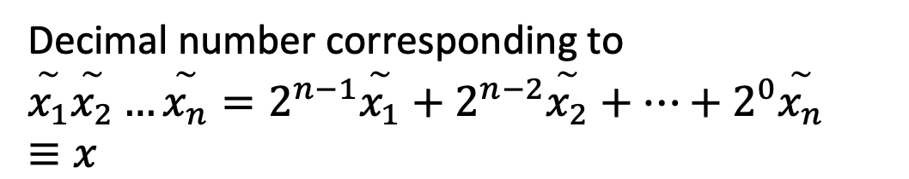
DFT on $n$ qubits
$|\left.x\right\rangle =\left\lceil \begin{aligned}x_{1} \\ x_{2} \\ . \\ . \\ . \\ x_{N}\end{aligned}\right\rceil$ $|\left.\overset{\sim }{x}\right\rangle =\frac{1}{\sqrt{N}}\left\lceil \begin{aligned}{\left(ω_{N}^{0}\right)}^{0} \\ {\left(ω_{N}^{0}\right)}^{1} \\ {\left(ω_{N}^{0}\right)}^{2} \\ . \\ . \\ .\end{aligned}\begin{aligned}{\left(ω_{N}^{1}\right)}^{0} \\ {\left(ω_{N}^{1}\right)}^{1} \\ {\left(ω_{N}^{1}\right)}^{2} \\ . \\ . \\ .\end{aligned}\begin{aligned}{\left(ω_{N}^{2}\right)}^{0} \\ {\left(ω_{N}^{2}\right)}^{1} \\ {\left(ω_{N}^{2}\right)}^{2} \\ . \\ . \\ .\end{aligned}\begin{aligned}{\left(ω_{N}^{3}\right)}^{0} \\ {\left(ω_{N}^{3}\right)}^{1} \\ {\left(ω_{N}^{3}\right)}^{2} \\ . \\ . \\ .\end{aligned} \begin{aligned}. \\ . \\ \\ . \\ \\ . \\ . \\ .\end{aligned} \begin{aligned}. \\ . \\ \\ . \\ \\ . \\ . \\ .\end{aligned}\right\rceil |\left.x\right\rangle$
$|\left.x\right\rangle =|\left.\overset{\sim }{x_{1}}\overset{\sim }{x_{2}}…\overset{\sim }{x_{n}}\right\rangle$ and $|\left.x\right\rangle =\left[\begin{aligned}0 \\ 0 \\ 0 \\ . \\ 1 \\ . \\ 0\end{aligned}\right]$
Decimal number corresponding to
$$\overset{\sim }{x_{1}}\overset{\sim }{x_{2}}…\overset{\sim }{x_{n}}=2^{n−1}\overset{\sim }{x_{1}}+2^{n−2}\overset{\sim }{x_{2}}+…+2^{0}\overset{\sim }{x_{n}}≡x$$

Slide 24
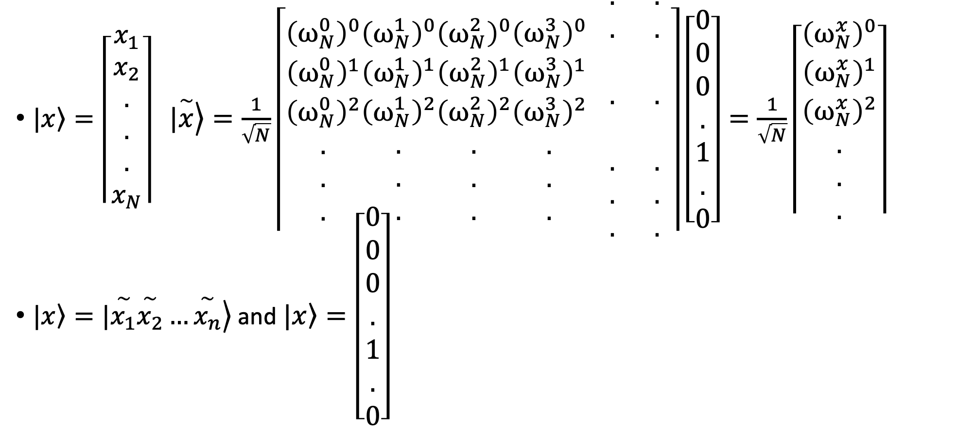
DFT on $n$ qubits
$|\left.x\right\rangle =\left\lceil \begin{aligned}x_{1} \\ x_{2} \\ . \\ . \\ . \\ x_{N}\end{aligned}\right\rceil$ $|\left.\overset{\sim }{x}\right\rangle =\frac{1}{\sqrt{N}}\left\lceil \begin{aligned}{\left(ω_{N}^{0}\right)}^{0} \\ {\left(ω_{N}^{0}\right)}^{1} \\ {\left(ω_{N}^{0}\right)}^{2} \\ . \\ . \\ .\end{aligned}\begin{aligned}{\left(ω_{N}^{1}\right)}^{0} \\ {\left(ω_{N}^{1}\right)}^{1} \\ {\left(ω_{N}^{1}\right)}^{2} \\ . \\ . \\ .\end{aligned}\begin{aligned}{\left(ω_{N}^{2}\right)}^{0} \\ {\left(ω_{N}^{2}\right)}^{1} \\ {\left(ω_{N}^{2}\right)}^{2} \\ . \\ . \\ .\end{aligned}\begin{aligned}{\left(ω_{N}^{3}\right)}^{0} \\ {\left(ω_{N}^{3}\right)}^{1} \\ {\left(ω_{N}^{3}\right)}^{2} \\ . \\ . \\ .\end{aligned} \begin{aligned}. \\ . \\ \\ . \\ \\ . \\ . \\ .\end{aligned} \begin{aligned}. \\ . \\ \\ . \\ \\ . \\ . \\ .\end{aligned}\right\rceil \left[\begin{aligned}0 \\ 0 \\ 0 \\ . \\ 1 \\ . \\ 0\end{aligned}\right]=\frac{1}{\sqrt{N}}\left\lceil \begin{aligned}{\left(ω_{N}^{x}\right)}^{0} \\ {\left(ω_{N}^{x}\right)}^{1} \\ {\left(ω_{N}^{x}\right)}^{2} \\ . \\ . \\ .\end{aligned}\right\rceil$
$|\left.x\right\rangle =|\left.\overset{\sim }{x_{1}}\overset{\sim }{x_{2}}…\overset{\sim }{x_{n}}\right\rangle$ and $|\left.x\right\rangle =\left[\begin{aligned}0 \\ 0 \\ 0 \\ . \\ 1 \\ . \\ 0\end{aligned}\right]$
Decimal number corresponding to
$$\overset{\sim }{x_{1}}\overset{\sim }{x_{2}}…\overset{\sim }{x_{n}}=2^{n−1}\overset{\sim }{x_{1}}+2^{n−2}\overset{\sim }{x_{2}}+…+2^{0}\overset{\sim }{x_{n}}≡x$$

Slide 25
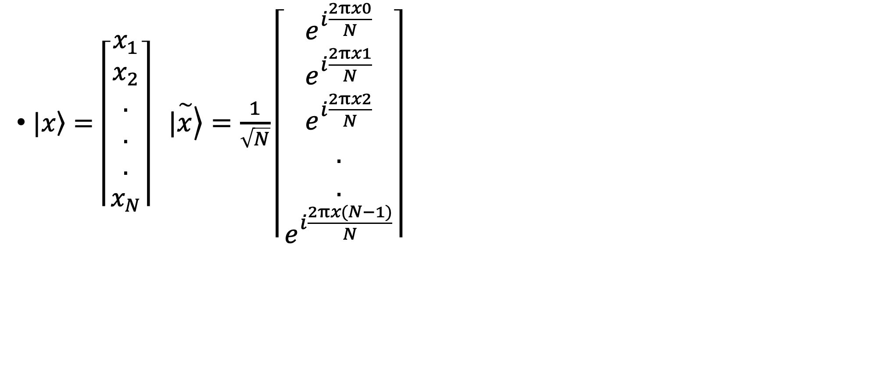
DFT on $n$ qubits
$|\left.x\right\rangle =\left\lceil \begin{aligned}x_{1} \\ x_{2} \\ . \\ . \\ . \\ x_{N}\end{aligned}\right\rceil$ $|\left.\overset{\sim }{x}\right\rangle =\frac{1}{\sqrt{N}}\left\lceil \begin{aligned}e^{i\frac{2πx0}{N}} \\ e^{i\frac{2πx1}{N}} \\ e^{i\frac{2πx2}{N}} \\ . \\ . \\ e^{i\frac{2πx(N−1)}{N}}\end{aligned}\right\rceil$

Slide 26
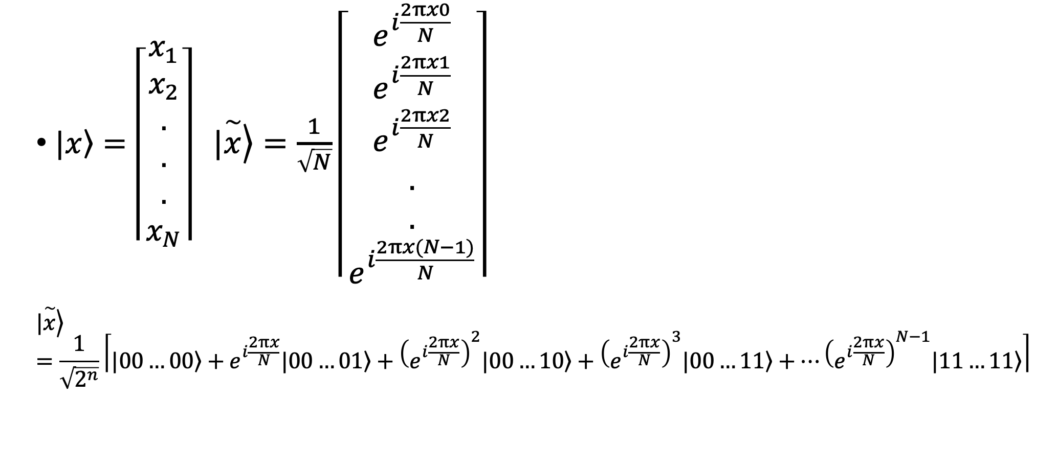
DFT on $n$ qubits
$|\left.x\right\rangle =\left\lceil \begin{aligned}x_{1} \\ x_{2} \\ . \\ . \\ . \\ x_{N}\end{aligned}\right\rceil$ $|\left.\overset{\sim }{x}\right\rangle =\frac{1}{\sqrt{N}}\left\lceil \begin{aligned}e^{i\frac{2πx0}{N}} \\ e^{i\frac{2πx1}{N}} \\ e^{i\frac{2πx2}{N}} \\ . \\ . \\ e^{i\frac{2πx(N−1)}{N}}\end{aligned}\right\rceil$
$$|\left.\overset{\sim }{x}\right\rangle =\frac{1}{\sqrt{2^{n}}}\left\lceil |\left.00…00\right\rangle +e^{i\frac{2πx}{N}}|\left.00…01\right\rangle +{\left(e^{i\frac{2πx}{N}}\right)}^{2}|\left.00…10\right\rangle +{\left(e^{i\frac{2πx}{N}}\right)}^{3}|\left.00…11\right\rangle +…{\left(e^{i\frac{2πx}{N}}\right)}^{N−1}|\left.11…11\right\rangle \right\rceil$$

Slide 27
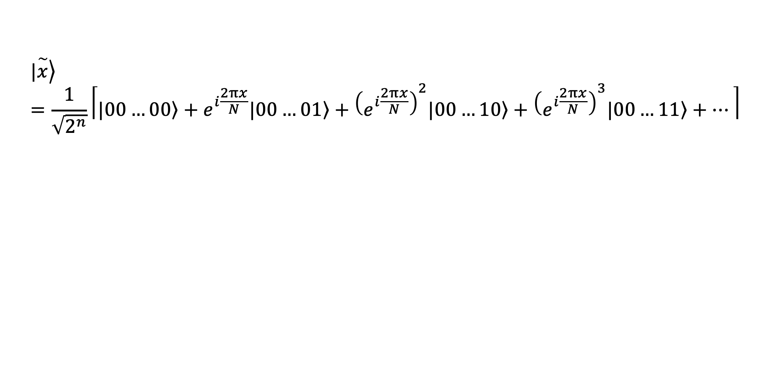
DFT on $n$ qubits
$$|\left.\overset{\sim }{x}\right\rangle =\frac{1}{\sqrt{2^{n}}}\left\lceil |\left.00…00\right\rangle +e^{i\frac{2πx}{N}}|\left.00…01\right\rangle +{\left(e^{i\frac{2πx}{N}}\right)}^{2}|\left.00…10\right\rangle +{\left(e^{i\frac{2πx}{N}}\right)}^{3}|\left.00…11\right\rangle +…\right\rceil$$

Slide 28
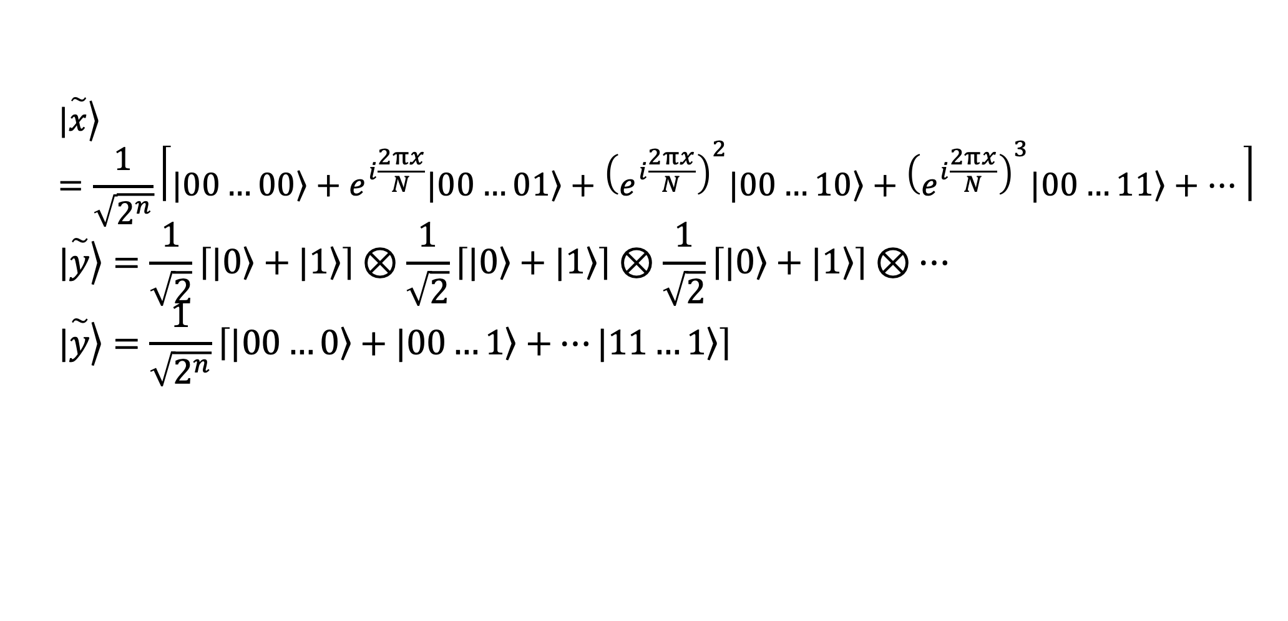
DFT on $n$ qubits
$$|\left.\overset{\sim }{x}\right\rangle =\frac{1}{\sqrt{2^{n}}}\left\lceil |\left.00…00\right\rangle +e^{i\frac{2πx}{N}}|\left.00…01\right\rangle +{\left(e^{i\frac{2πx}{N}}\right)}^{2}|\left.00…10\right\rangle +{\left(e^{i\frac{2πx}{N}}\right)}^{3}|\left.00…11\right\rangle +…\right\rceil$$
$$|\left.\overset{\sim }{y}\right\rangle =\frac{1}{\sqrt{2}}\left\lceil |\left.0\right\rangle +|\left.1\right\rangle \right\rceil ⊗\frac{1}{\sqrt{2}}\left\lceil |\left.0\right\rangle +|\left.1\right\rangle \right\rceil ⊗\frac{1}{\sqrt{2}}\left\lceil |\left.0\right\rangle +|\left.1\right\rangle \right\rceil ⊗…$$
$$|\left.\overset{\sim }{y}\right\rangle =\frac{1}{\sqrt{2^{n}}}\left\lceil |\left.00…0\right\rangle +|\left.00…1\right\rangle +…|\left.11…1\right\rangle \right\rceil$$

Slide 29
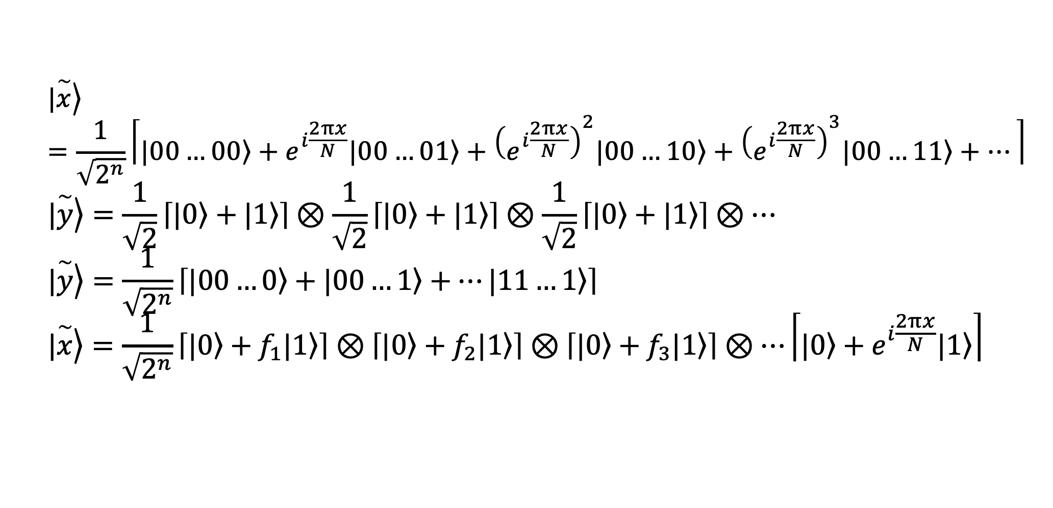
DFT on $n$ qubits
$$|\left.\overset{\sim }{x}\right\rangle =\frac{1}{\sqrt{2^{n}}}\left\lceil |\left.00…00\right\rangle +e^{i\frac{2πx}{N}}|\left.00…01\right\rangle +{\left(e^{i\frac{2πx}{N}}\right)}^{2}|\left.00…10\right\rangle +{\left(e^{i\frac{2πx}{N}}\right)}^{3}|\left.00…11\right\rangle +…\right\rceil$$
$$|\left.\overset{\sim }{y}\right\rangle =\frac{1}{\sqrt{2}}\left\lceil |\left.0\right\rangle +|\left.1\right\rangle \right\rceil ⊗\frac{1}{\sqrt{2}}\left\lceil |\left.0\right\rangle +|\left.1\right\rangle \right\rceil ⊗\frac{1}{\sqrt{2}}\left\lceil |\left.0\right\rangle +|\left.1\right\rangle \right\rceil ⊗…$$
$$|\left.\overset{\sim }{y}\right\rangle =\frac{1}{\sqrt{2^{n}}}\left\lceil |\left.00…0\right\rangle +|\left.00…1\right\rangle +…|\left.11…1\right\rangle \right\rceil$$
$$|\left.\overset{\sim }{x}\right\rangle =\frac{1}{\sqrt{2^{n}}}\left\lceil |\left.0\right\rangle +f_{1}|\left.1\right\rangle \right\rceil ⊗\left\lceil |\left.0\right\rangle +f_{2}|\left.1\right\rangle \right\rceil ⊗\left\lceil |\left.0\right\rangle +f_{3}|\left.1\right\rangle \right\rceil ⊗…\left\lceil |\left.0\right\rangle +e^{i\frac{2πx}{N}}|\left.1\right\rangle \right\rceil$$

Slide 30
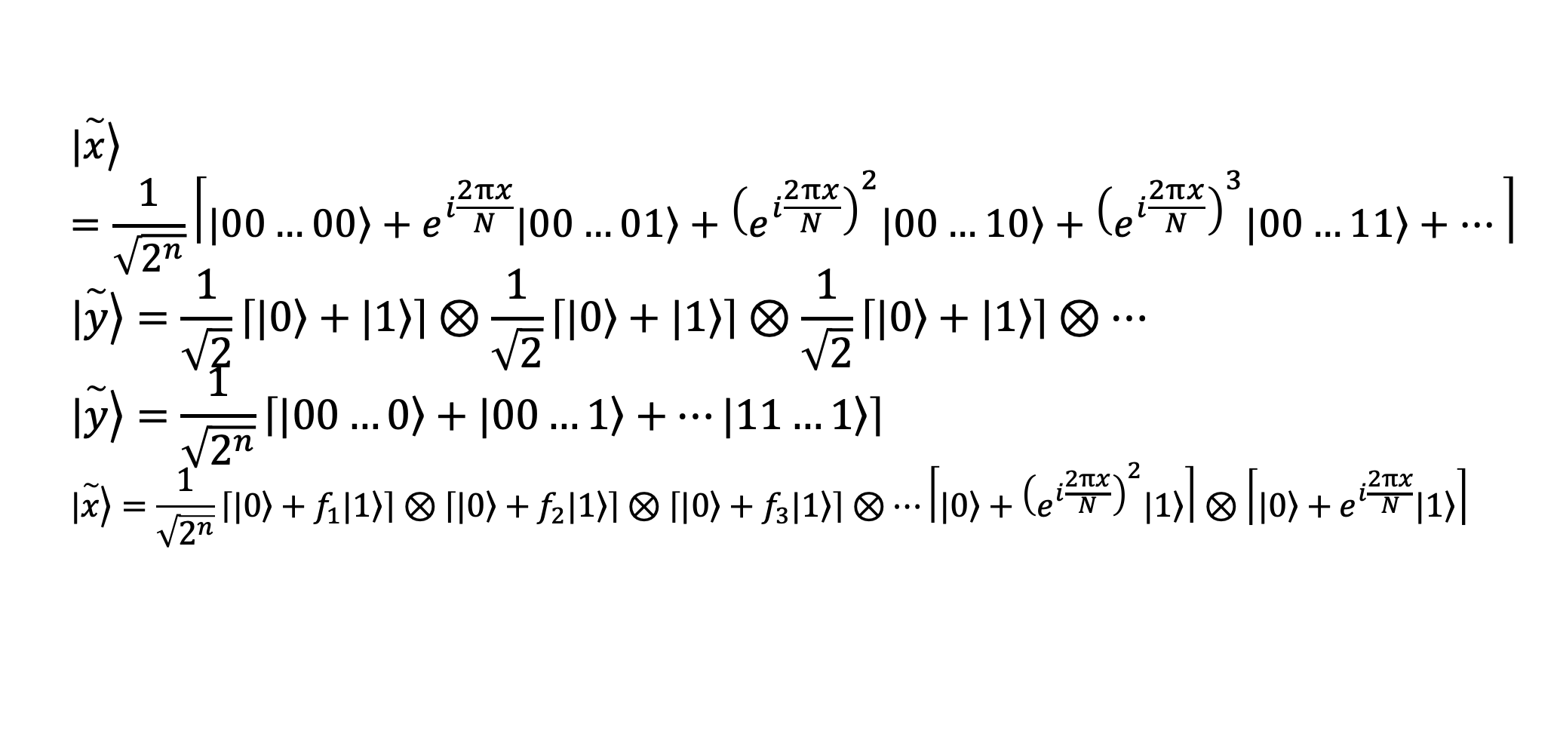
DFT on $n$ qubits
$$|\left.\overset{\sim }{x}\right\rangle =\frac{1}{\sqrt{2^{n}}}\left\lceil |\left.00…00\right\rangle +e^{i\frac{2πx}{N}}|\left.00…01\right\rangle +{\left(e^{i\frac{2πx}{N}}\right)}^{2}|\left.00…10\right\rangle +{\left(e^{i\frac{2πx}{N}}\right)}^{3}|\left.00…11\right\rangle +…\right\rceil$$
$$|\left.\overset{\sim }{y}\right\rangle =\frac{1}{\sqrt{2}}\left\lceil |\left.0\right\rangle +|\left.1\right\rangle \right\rceil ⊗\frac{1}{\sqrt{2}}\left\lceil |\left.0\right\rangle +|\left.1\right\rangle \right\rceil ⊗\frac{1}{\sqrt{2}}\left\lceil |\left.0\right\rangle +|\left.1\right\rangle \right\rceil ⊗…$$
$$|\left.\overset{\sim }{y}\right\rangle =\frac{1}{\sqrt{2^{n}}}\left\lceil |\left.00…0\right\rangle +|\left.00…1\right\rangle +…|\left.11…1\right\rangle \right\rceil$$
$$|\left.\overset{\sim }{x}\right\rangle =\frac{1}{\sqrt{2^{n}}}\left\lceil |\left.0\right\rangle +f_{1}|\left.1\right\rangle \right\rceil ⊗\left\lceil |\left.0\right\rangle +f_{2}|\left.1\right\rangle \right\rceil ⊗\left\lceil |\left.0\right\rangle +f_{3}|\left.1\right\rangle \right\rceil ⊗…\left\lceil |\left.0\right\rangle +{\left(e^{i\frac{2πx}{N}}\right)}^{2}|\left.1\right\rangle \right\rceil ⊗\left\lceil |\left.0\right\rangle +e^{i\frac{2πx}{N}}|\left.1\right\rangle \right\rceil$$

Slide 31
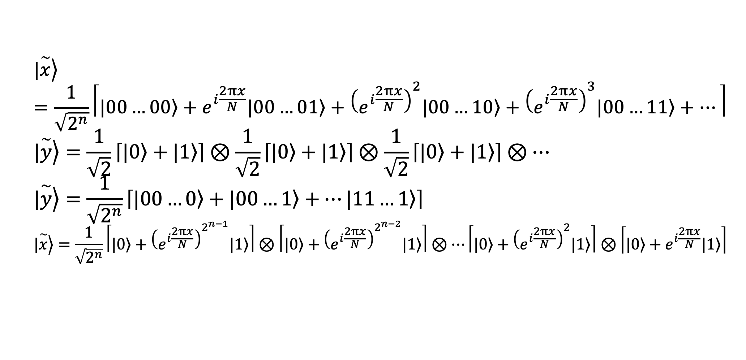
DFT on $n$ qubits
$$|\left.\overset{\sim }{x}\right\rangle =\frac{1}{\sqrt{2^{n}}}\left\lceil |\left.00…00\right\rangle +e^{i\frac{2πx}{N}}|\left.00…01\right\rangle +{\left(e^{i\frac{2πx}{N}}\right)}^{2}|\left.00…10\right\rangle +{\left(e^{i\frac{2πx}{N}}\right)}^{3}|\left.00…11\right\rangle +…\right\rceil$$
$$|\left.\overset{\sim }{y}\right\rangle =\frac{1}{\sqrt{2}}\left\lceil |\left.0\right\rangle +|\left.1\right\rangle \right\rceil ⊗\frac{1}{\sqrt{2}}\left\lceil |\left.0\right\rangle +|\left.1\right\rangle \right\rceil ⊗\frac{1}{\sqrt{2}}\left\lceil |\left.0\right\rangle +|\left.1\right\rangle \right\rceil ⊗…$$
$$|\left.\overset{\sim }{y}\right\rangle =\frac{1}{\sqrt{2^{n}}}\left\lceil |\left.00…0\right\rangle +|\left.00…1\right\rangle +…|\left.11…1\right\rangle \right\rceil$$
$$|\left.\overset{\sim }{x}\right\rangle =\frac{1}{\sqrt{2^{n}}}\left\lceil |\left.0\right\rangle +{\left(e^{i\frac{2πx}{N}}\right)}^{2^{n−1}}|\left.1\right\rangle \right\rceil ⊗\left\lceil |\left.0\right\rangle +{\left(e^{i\frac{2πx}{N}}\right)}^{2^{n−2}}|\left.1\right\rangle \right\rceil ⊗…\left\lceil |\left.0\right\rangle +{\left(e^{i\frac{2πx}{N}}\right)}^{2}|\left.1\right\rangle \right\rceil ⊗\left\lceil |\left.0\right\rangle +e^{i\frac{2πx}{N}}|\left.1\right\rangle \right\rceil$$

Slide 32
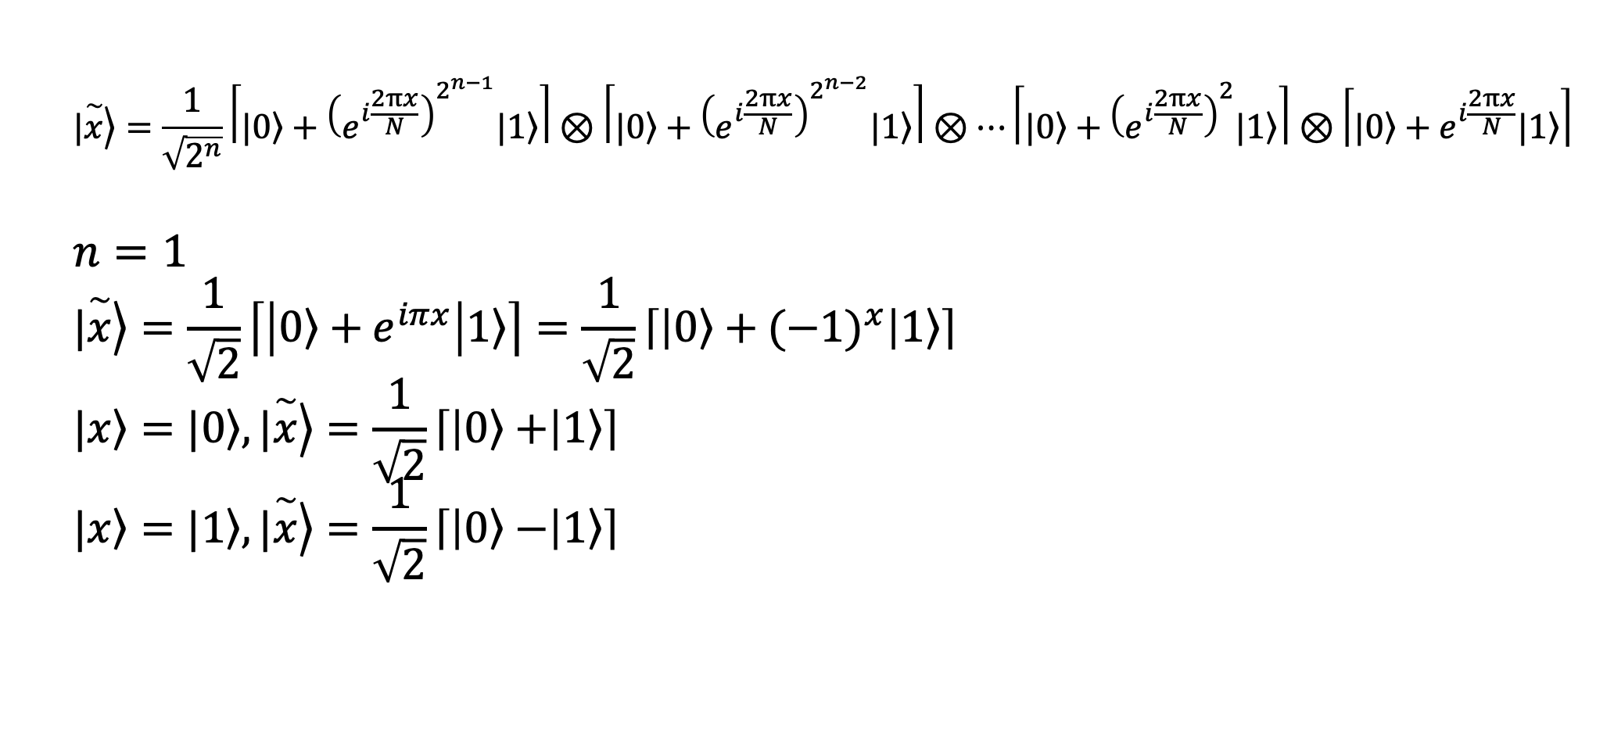
DFT on $n$ qubits
$$|\left.\overset{\sim }{x}\right\rangle =\frac{1}{\sqrt{2^{n}}}\left\lceil |\left.0\right\rangle +{\left(e^{i\frac{2πx}{N}}\right)}^{2^{n−1}}|\left.1\right\rangle \right\rceil ⊗\left\lceil |\left.0\right\rangle +{\left(e^{i\frac{2πx}{N}}\right)}^{2^{n−2}}|\left.1\right\rangle \right\rceil ⊗…\left\lceil |\left.0\right\rangle +{\left(e^{i\frac{2πx}{N}}\right)}^{2}|\left.1\right\rangle \right\rceil ⊗\left\lceil |\left.0\right\rangle +e^{i\frac{2πx}{N}}|\left.1\right\rangle \right\rceil$$
$$n=1$$
$$|\left.\overset{\sim }{x}\right\rangle =\frac{1}{\sqrt{2}}\left\lceil \left|\left.0\right\rangle +e^{iπx}\right|\left.1\right\rangle \right\rceil =\frac{1}{\sqrt{2}}\left\lceil \left|\left.0\right\rangle +{(−1)}^{x}\right|\left.1\right\rangle \right\rceil$$
$$|\left.x\right\rangle =|\left.0\right\rangle , |\left.\overset{\sim }{x}\right\rangle =\frac{1}{\sqrt{2}}\left\lceil \left|\left.0\right\rangle +\right|\left.1\right\rangle \right\rceil$$
$$|\left.x\right\rangle =|\left.1\right\rangle , |\left.\overset{\sim }{x}\right\rangle =\frac{1}{\sqrt{2}}\left\lceil \left|\left.0\right\rangle −\right|\left.1\right\rangle \right\rceil$$

Slide 33
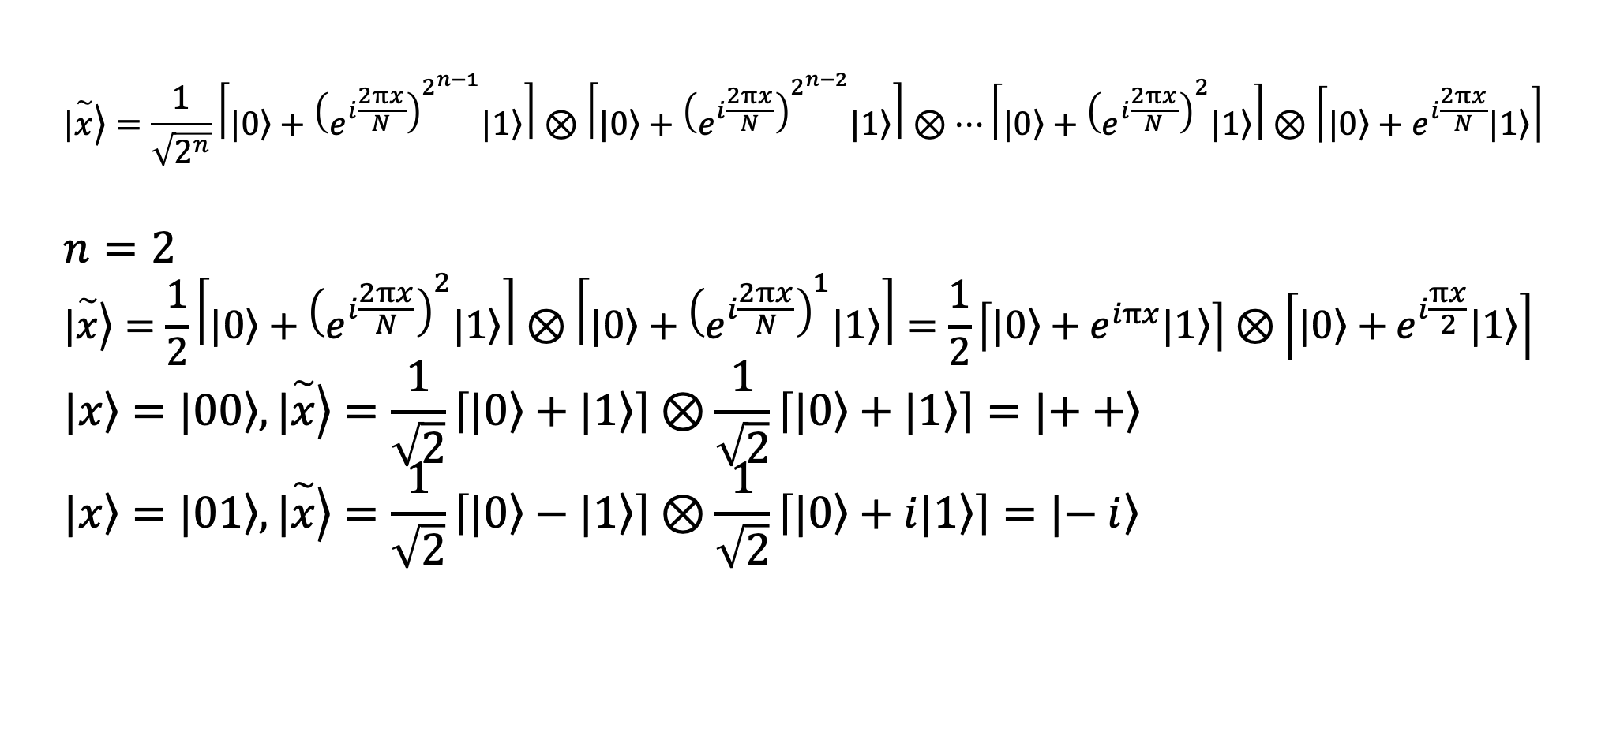
DFT on $n$ qubits
$$|\left.\overset{\sim }{x}\right\rangle =\frac{1}{\sqrt{2^{n}}}\left\lceil |\left.0\right\rangle +{\left(e^{i\frac{2πx}{N}}\right)}^{2^{n−1}}|\left.1\right\rangle \right\rceil ⊗\left\lceil |\left.0\right\rangle +{\left(e^{i\frac{2πx}{N}}\right)}^{2^{n−2}}|\left.1\right\rangle \right\rceil ⊗…\left\lceil |\left.0\right\rangle +{\left(e^{i\frac{2πx}{N}}\right)}^{2}|\left.1\right\rangle \right\rceil ⊗\left\lceil |\left.0\right\rangle +e^{i\frac{2πx}{N}}|\left.1\right\rangle \right\rceil$$
$$n=2$$
$$|\left.\overset{\sim }{x}\right\rangle =\frac{1}{2}\left\lceil \left.|0\right\rangle +{\left(e^{i\frac{2πx}{N}}\right)}^{2}\left.|1\right\rangle \right\rceil ⊗\left\lceil |\left.0\right\rangle +{\left(e^{i\frac{2πx}{N}}\right)}^{1}|\left.1\right\rangle \right\rceil =\frac{1}{2}\left\lceil \left.|0\right\rangle +e^{iπx}\left.|1\right\rangle \right\rceil ⊗\left\lceil |\left.0\right\rangle +e^{i\frac{πx}{2}}|\left.1\right\rangle \right\rceil$$
$$|\left.x\right\rangle =|\left.00\right\rangle , |\left.\overset{\sim }{x}\right\rangle =\frac{1}{\sqrt{2}}\left\lceil \left.|0\right\rangle +\left.|1\right\rangle \right\rceil ⊗\frac{1}{\sqrt{2}}\left\lceil |\left.0\right\rangle +|\left.1\right\rangle \right\rceil =|\left.++\right\rangle$$
$$|\left.x\right\rangle =|\left.01\right\rangle , |\left.\overset{\sim }{x}\right\rangle =\frac{1}{\sqrt{2}}\left\lceil \left.|0\right\rangle −\left.|1\right\rangle \right\rceil ⊗\frac{1}{\sqrt{2}}\left\lceil |\left.0\right\rangle +i|\left.1\right\rangle \right\rceil =|\left.− i\right\rangle$$

Slide 34
Outline
General overview
Implementation of DFT
Quantum phase estimation

Slide 35
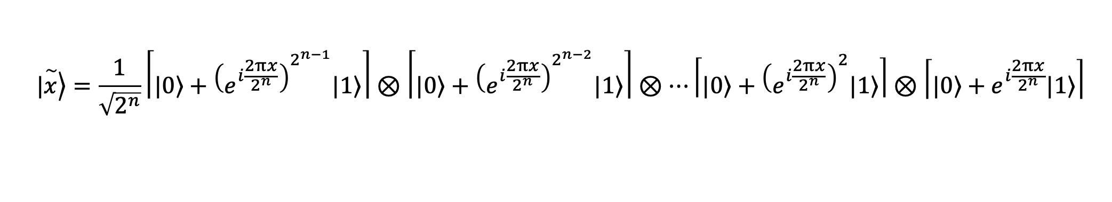
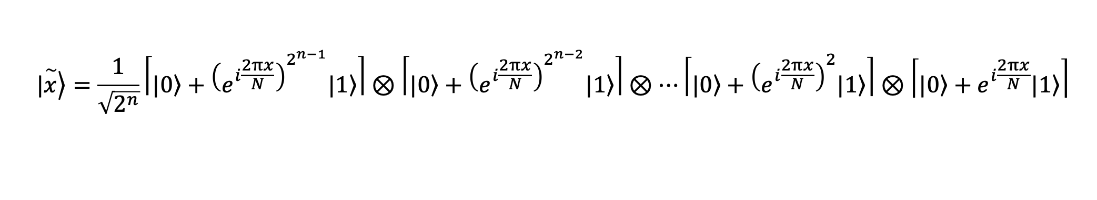
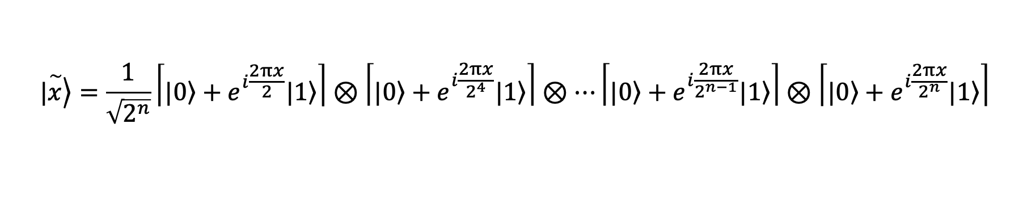
Implementation of DFT
$$|\left.\overset{\sim }{x}\right\rangle =\frac{1}{\sqrt{2^{n}}}\left\lceil |\left.0\right\rangle +{\left(e^{i\frac{2πx}{N}}\right)}^{2^{n−1}}|\left.1\right\rangle \right\rceil ⊗\left\lceil |\left.0\right\rangle +{\left(e^{i\frac{2πx}{N}}\right)}^{2^{n−2}}|\left.1\right\rangle \right\rceil ⊗…\left\lceil |\left.0\right\rangle +{\left(e^{i\frac{2πx}{N}}\right)}^{2}|\left.1\right\rangle \right\rceil ⊗\left\lceil |\left.0\right\rangle +e^{i\frac{2πx}{N}}|\left.1\right\rangle \right\rceil$$
$$|\left.\overset{\sim }{x}\right\rangle =\frac{1}{\sqrt{2^{n}}}\left\lceil |\left.0\right\rangle +{\left(e^{i\frac{2πx}{2^{n}}}\right)}^{2^{n−1}}|\left.1\right\rangle \right\rceil ⊗\left\lceil |\left.0\right\rangle +{\left(e^{i\frac{2πx}{2^{n}}}\right)}^{2^{n−2}}|\left.1\right\rangle \right\rceil ⊗…\left\lceil |\left.0\right\rangle +{\left(e^{i\frac{2πx}{2^{n}}}\right)}^{2}|\left.1\right\rangle \right\rceil ⊗\left\lceil |\left.0\right\rangle +e^{i\frac{2πx}{2^{n}}}|\left.1\right\rangle \right\rceil$$
$$|\left.\overset{\sim }{x}\right\rangle =\frac{1}{\sqrt{2^{n}}}\left\lceil |\left.0\right\rangle +e^{i\frac{2πx}{2}}|\left.1\right\rangle \right\rceil ⊗\left\lceil |\left.0\right\rangle +e^{i\frac{2πx}{2^{4}}}|\left.1\right\rangle \right\rceil ⊗…\left\lceil |\left.0\right\rangle +e^{i\frac{2πx}{2^{n−1}}}|\left.1\right\rangle \right\rceil ⊗\left\lceil |\left.0\right\rangle +e^{i\frac{2πx}{2^{n}}}|\left.1\right\rangle \right\rceil$$

Slide 36
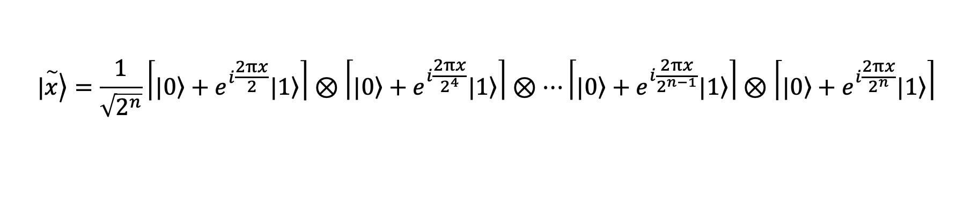
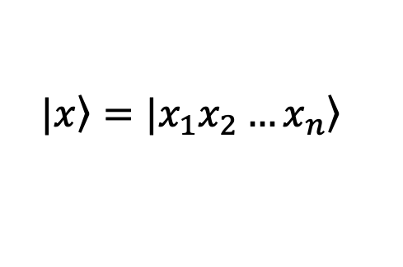
Implementation of DFT
DFT
$$|\left.x\right\rangle =|x_{1}x_{2}…\left.x_{n}\right\rangle$$
$$|\left.\overset{\sim }{x}\right\rangle =\frac{1}{\sqrt{2^{n}}}\left\lceil |\left.0\right\rangle +e^{i\frac{2πx}{2}}|\left.1\right\rangle \right\rceil ⊗\left\lceil |\left.0\right\rangle +e^{i\frac{2πx}{2^{4}}}|\left.1\right\rangle \right\rceil ⊗…\left\lceil |\left.0\right\rangle +e^{i\frac{2πx}{2^{n−1}}}|\left.1\right\rangle \right\rceil ⊗\left\lceil |\left.0\right\rangle +e^{i\frac{2πx}{2^{n}}}|\left.1\right\rangle \right\rceil$$

Slide 37




Implementation of DFT
DFT
$$|\left.x\right\rangle =|x_{1}x_{2}…\left.x_{n}\right\rangle$$
$$|\left.\overset{\sim }{x}\right\rangle =\frac{1}{\sqrt{2^{n}}}\left\lceil |\left.0\right\rangle +e^{i\frac{2πx}{2}}|\left.1\right\rangle \right\rceil ⊗\left\lceil |\left.0\right\rangle +e^{i\frac{2πx}{2^{4}}}|\left.1\right\rangle \right\rceil ⊗…\left\lceil |\left.0\right\rangle +e^{i\frac{2πx}{2^{n−1}}}|\left.1\right\rangle \right\rceil ⊗\left\lceil |\left.0\right\rangle +e^{i\frac{2πx}{2^{n}}}|\left.1\right\rangle \right\rceil$$
$$x_{n}$$
$$x_{n−1}$$
$$x_{2}$$
$$x_{1}$$

Slide 38
Implementation of DFT
DFT
$$|\left.x\right\rangle =|x_{1}x_{2}…\left.x_{n}\right\rangle$$
$$|\left.\overset{\sim }{x}\right\rangle =\frac{1}{\sqrt{2^{n}}}\left\lceil |\left.0\right\rangle +e^{i\frac{2πx}{2}}|\left.1\right\rangle \right\rceil ⊗\left\lceil |\left.0\right\rangle +e^{i\frac{2πx}{2^{4}}}|\left.1\right\rangle \right\rceil ⊗…\left\lceil |\left.0\right\rangle +e^{i\frac{2πx}{2^{n−1}}}|\left.1\right\rangle \right\rceil ⊗\left\lceil |\left.0\right\rangle +e^{i\frac{2πx}{2^{n}}}|\left.1\right\rangle \right\rceil$$
$$x_{n}$$
H
$$x_{n−1}$$
$$x_{2}$$
$$x_{1}$$

Slide 39
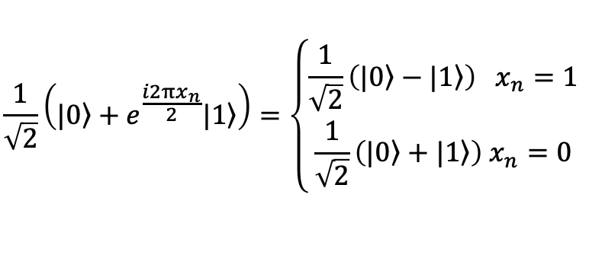
Implementation of DFT
DFT
$$|\left.x\right\rangle =|x_{1}x_{2}…\left.x_{n}\right\rangle$$
$$|\left.\overset{\sim }{x}\right\rangle =\frac{1}{\sqrt{2^{n}}}\left\lceil |\left.0\right\rangle +e^{i\frac{2πx}{2}}|\left.1\right\rangle \right\rceil ⊗\left\lceil |\left.0\right\rangle +e^{i\frac{2πx}{2^{4}}}|\left.1\right\rangle \right\rceil ⊗…\left\lceil |\left.0\right\rangle +e^{i\frac{2πx}{2^{n−1}}}|\left.1\right\rangle \right\rceil ⊗\left\lceil |\left.0\right\rangle +e^{i\frac{2πx}{2^{n}}}|\left.1\right\rangle \right\rceil$$
$$x_{n}$$
H
$$\frac{1}{\sqrt{2}}\left(|\left.0\right\rangle +e^{\frac{i2πx_{n}}{2}}|\left.1\right\rangle \right)=\left\{\begin{aligned}\frac{1}{\sqrt{2}}\left(|\left.0\right\rangle −|\left.1\right\rangle \right) x_{n}=1 \\ \frac{1}{\sqrt{2}}\left(|\left.0\right\rangle +|\left.1\right\rangle \right) x_{n}=0\end{aligned}\right.$$

Slide 40
Implementation of DFT
DFT
$$|\left.x\right\rangle =|x_{1}x_{2}…\left.x_{n}\right\rangle$$
$$|\left.\overset{\sim }{x}\right\rangle =\frac{1}{\sqrt{2^{n}}}\left\lceil |\left.0\right\rangle +e^{i\frac{2πx}{2}}|\left.1\right\rangle \right\rceil ⊗\left\lceil |\left.0\right\rangle +e^{i\frac{2πx}{2^{4}}}|\left.1\right\rangle \right\rceil ⊗…\left\lceil |\left.0\right\rangle +e^{i\frac{2πx}{2^{n−1}}}|\left.1\right\rangle \right\rceil ⊗\left\lceil |\left.0\right\rangle +e^{i\frac{2πx}{2^{n}}}|\left.1\right\rangle \right\rceil$$
$$x_{n}$$
H
$$x_{n−1}$$
$$\frac{1}{\sqrt{2}}\left(|\left.0\right\rangle +e^{\frac{i2πx_{n}}{2}}|\left.1\right\rangle \right)=\left\{\begin{aligned}\frac{1}{\sqrt{2}}\left(|\left.0\right\rangle −|\left.1\right\rangle \right) x_{n}=1 \\ \frac{1}{\sqrt{2}}\left(|\left.0\right\rangle +|\left.1\right\rangle \right) x_{n}=0\end{aligned}\right.$$

Slide 41
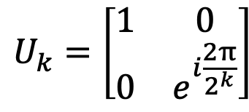

Implementation of DFT
DFT
$$|\left.x\right\rangle =|x_{1}x_{2}…\left.x_{n}\right\rangle$$
$$|\left.\overset{\sim }{x}\right\rangle =\frac{1}{\sqrt{2^{n}}}\left\lceil |\left.0\right\rangle +e^{i\frac{2πx}{2}}|\left.1\right\rangle \right\rceil ⊗\left\lceil |\left.0\right\rangle +e^{i\frac{2πx}{2^{4}}}|\left.1\right\rangle \right\rceil ⊗…\left\lceil |\left.0\right\rangle +e^{i\frac{2πx}{2^{n−1}}}|\left.1\right\rangle \right\rceil ⊗\left\lceil |\left.0\right\rangle +e^{i\frac{2πx}{2^{n}}}|\left.1\right\rangle \right\rceil$$
$$x_{n}$$
H
$$U_{2}$$
$$x_{n−1}$$
$$U_{k}=\left[\begin{matrix}1 & 0 \\ 0 & e^{i\frac{2π}{2^{k}}}\end{matrix}\right]$$
$$\frac{1}{\sqrt{2}}\left(|\left.0\right\rangle +e^{\frac{i2πx_{n}}{2}}|\left.1\right\rangle \right)=\left\{\begin{aligned}\frac{1}{\sqrt{2}}\left(|\left.0\right\rangle −|\left.1\right\rangle \right) x_{n}=1 \\ \frac{1}{\sqrt{2}}\left(|\left.0\right\rangle +|\left.1\right\rangle \right) x_{n}=0\end{aligned}\right.$$

Slide 42
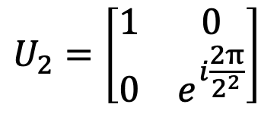
Implementation of DFT
DFT
$$|\left.x\right\rangle =|x_{1}x_{2}…\left.x_{n}\right\rangle$$
$$|\left.\overset{\sim }{x}\right\rangle =\frac{1}{\sqrt{2^{n}}}\left\lceil |\left.0\right\rangle +e^{i\frac{2πx}{2}}|\left.1\right\rangle \right\rceil ⊗\left\lceil |\left.0\right\rangle +e^{i\frac{2πx}{2^{4}}}|\left.1\right\rangle \right\rceil ⊗…\left\lceil |\left.0\right\rangle +e^{i\frac{2πx}{2^{n−1}}}|\left.1\right\rangle \right\rceil ⊗\left\lceil |\left.0\right\rangle +e^{i\frac{2πx}{2^{n}}}|\left.1\right\rangle \right\rceil$$
$$x_{n}$$
H
$$U_{2}$$
$$x_{n−1}$$
$$U_{k}=\left[\begin{matrix}1 & 0 \\ 0 & e^{i\frac{2π}{2^{k}}}\end{matrix}\right]$$
$$\frac{1}{\sqrt{2}}\left(|\left.0\right\rangle +e^{\frac{i2πx_{n}}{2}}|\left.1\right\rangle \right)=\left\{\begin{aligned}\frac{1}{\sqrt{2}}\left(|\left.0\right\rangle −|\left.1\right\rangle \right) x_{n}=1 \\ \frac{1}{\sqrt{2}}\left(|\left.0\right\rangle +|\left.1\right\rangle \right) x_{n}=0\end{aligned}\right.$$
$$U_{2}=\left[\begin{matrix}1 & 0 \\ 0 & e^{i\frac{2π}{2^{2}}}\end{matrix}\right]$$

Slide 43
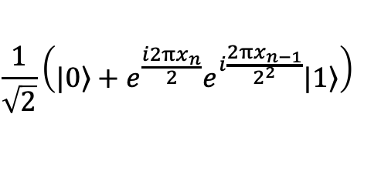
Implementation of DFT
DFT
$$|\left.x\right\rangle =|x_{1}x_{2}…\left.x_{n}\right\rangle$$
$$|\left.\overset{\sim }{x}\right\rangle =\frac{1}{\sqrt{2^{n}}}\left\lceil |\left.0\right\rangle +e^{i\frac{2πx}{2}}|\left.1\right\rangle \right\rceil ⊗\left\lceil |\left.0\right\rangle +e^{i\frac{2πx}{2^{4}}}|\left.1\right\rangle \right\rceil ⊗…\left\lceil |\left.0\right\rangle +e^{i\frac{2πx}{2^{n−1}}}|\left.1\right\rangle \right\rceil ⊗\left\lceil |\left.0\right\rangle +e^{i\frac{2πx}{2^{n}}}|\left.1\right\rangle \right\rceil$$
$$x_{n}$$
H
$$U_{2}$$
$$x_{n−1}$$
$$U_{k}=\left[\begin{matrix}1 & 0 \\ 0 & e^{i\frac{2π}{2^{k}}}\end{matrix}\right]$$
$$\frac{1}{\sqrt{2}}\left(|\left.0\right\rangle +e^{\frac{i2πx_{n}}{2}}|\left.1\right\rangle \right)=\left\{\begin{aligned}\frac{1}{\sqrt{2}}\left(|\left.0\right\rangle −|\left.1\right\rangle \right) x_{n}=1 \\ \frac{1}{\sqrt{2}}\left(|\left.0\right\rangle +|\left.1\right\rangle \right) x_{n}=0\end{aligned}\right.$$
$$\frac{1}{\sqrt{2}}\left(|\left.0\right\rangle +e^{\frac{i2πx_{n}}{2}}e^{i\frac{2πx_{n−1}}{2^{2}}}|\left.1\right\rangle \right)$$
$$U_{2}=\left[\begin{matrix}1 & 0 \\ 0 & e^{i\frac{2π}{2^{2}}}\end{matrix}\right]$$

Slide 44
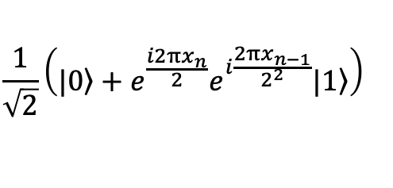
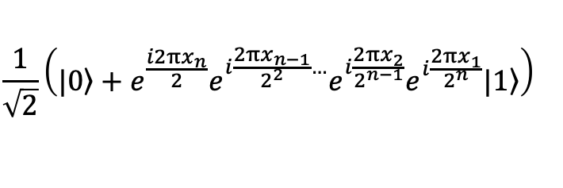


Implementation of DFT
DFT
$$|\left.x\right\rangle =|x_{1}x_{2}…\left.x_{n}\right\rangle$$
$$|\left.\overset{\sim }{x}\right\rangle =\frac{1}{\sqrt{2^{n}}}\left\lceil |\left.0\right\rangle +e^{i\frac{2πx}{2}}|\left.1\right\rangle \right\rceil ⊗\left\lceil |\left.0\right\rangle +e^{i\frac{2πx}{2^{4}}}|\left.1\right\rangle \right\rceil ⊗…\left\lceil |\left.0\right\rangle +e^{i\frac{2πx}{2^{n−1}}}|\left.1\right\rangle \right\rceil ⊗\left\lceil |\left.0\right\rangle +e^{i\frac{2πx}{2^{n}}}|\left.1\right\rangle \right\rceil$$
$$x_{n}$$
H
$$U_{2}$$
$$U_{n−1}$$
$$U_{n}$$
$$x_{n−1}$$
$$x_{2}$$
$$x_{1}$$
$$\frac{1}{\sqrt{2}}\left(|\left.0\right\rangle +e^{\frac{i2πx_{n}}{2}}e^{i\frac{2πx_{n−1}}{2^{2}}}|\left.1\right\rangle \right)$$
$$\frac{1}{\sqrt{2}}\left(|\left.0\right\rangle +e^{\frac{i2πx_{n}}{2}}e^{i\frac{2πx_{n−1}}{2^{2}}…}e^{i\frac{2πx_{2}}{2^{n−1}}}e^{i\frac{2πx_{1}}{2^{n}}}|\left.1\right\rangle \right)$$

Slide 45
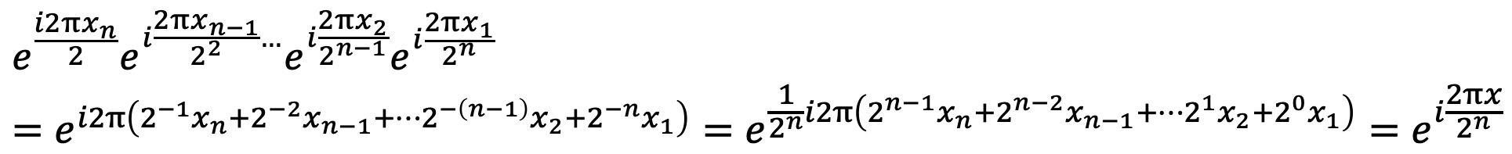
Implementation of DFT
$$e^{\frac{i2πx_{n}}{2}}e^{i\frac{2πx_{n−1}}{2^{2}}…}e^{i\frac{2πx_{2}}{2^{n−1}}}e^{i\frac{2πx_{1}}{2^{n}}}$$
$$=e^{i2π\left(2^{−1}x_{n}+2^{−2}x_{n−1}+…2^{−\left(n−1\right)}x_{2}+2^{−n}x_{1}\right)}=e^{\frac{1}{2^{n}}i2π\left(2^{n−1}x_{n}+2^{n−2}x_{n−1}+…2^{1}x_{2}+2^{0}x_{1}\right)}=e^{i\frac{2πx}{2^{n}}}$$
$$x_{n}$$
H
$$U_{2}$$
$$U_{n−1}$$
$$U_{n}$$
$$x_{n−1}$$
$$x_{2}$$
$$x_{1}$$
$$\frac{1}{\sqrt{2}}\left(|\left.0\right\rangle +e^{\frac{i2πx_{n}}{2}}e^{i\frac{2πx_{n−1}}{2^{2}}}|\left.1\right\rangle \right)$$
$$\frac{1}{\sqrt{2}}\left(|\left.0\right\rangle +e^{\frac{i2πx_{n}}{2}}e^{i\frac{2πx_{n−1}}{2^{2}}…}e^{i\frac{2πx_{2}}{2^{n−1}}}e^{i\frac{2πx_{1}}{2^{n}}}|\left.1\right\rangle \right)$$

Slide 46
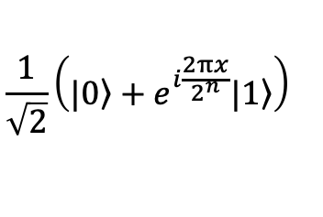
Implementation of DFT
$$e^{\frac{i2πx_{n}}{2}}e^{i\frac{2πx_{n−1}}{2^{2}}…}e^{i\frac{2πx_{2}}{2^{n−1}}}e^{i\frac{2πx_{1}}{2^{n}}}$$
$$=e^{i2π\left(2^{−1}x_{n}+2^{−2}x_{n−1}+…2^{−\left(n−1\right)}x_{2}+2^{−n}x_{1}\right)}=e^{\frac{1}{2^{n}}i2π\left(2^{n−1}x_{n}+2^{n−2}x_{n−1}+…2^{1}x_{2}+2^{0}x_{1}\right)}=e^{i\frac{2πx}{2^{n}}}$$
$$x_{n}$$
H
$$U_{2}$$
$$U_{n−1}$$
$$U_{n}$$
$$x_{n−1}$$
$$x_{2}$$
$$x_{1}$$
$$\frac{1}{\sqrt{2}}\left(|\left.0\right\rangle +e^{\frac{i2πx_{n}}{2}}e^{i\frac{2πx_{n−1}}{2^{2}}}|\left.1\right\rangle \right)$$
$$\frac{1}{\sqrt{2}}\left(|\left.0\right\rangle +e^{i\frac{2πx}{2^{n}}}|\left.1\right\rangle \right)$$

Slide 47
Implementation of DFT
DFT
$$|\left.x\right\rangle =|x_{1}x_{2}…\left.x_{n}\right\rangle$$
$$|\left.\overset{\sim }{x}\right\rangle =\frac{1}{\sqrt{2^{n}}}\left\lceil |\left.0\right\rangle +e^{i\frac{2πx}{2}}|\left.1\right\rangle \right\rceil ⊗\left\lceil |\left.0\right\rangle +e^{i\frac{2πx}{2^{4}}}|\left.1\right\rangle \right\rceil ⊗…\left\lceil |\left.0\right\rangle +e^{i\frac{2πx}{2^{n−1}}}|\left.1\right\rangle \right\rceil ⊗\left\lceil |\left.0\right\rangle +e^{i\frac{2πx}{2^{n}}}|\left.1\right\rangle \right\rceil$$
$$x_{n}$$
H
$$U_{2}$$
$$U_{n−1}$$
$$U_{n}$$
$$x_{n−1}$$
$$x_{2}$$
$$x_{1}$$
$$\frac{1}{\sqrt{2}}\left(|\left.0\right\rangle +e^{\frac{i2πx_{n}}{2}}e^{i\frac{2πx_{n−1}}{2^{2}}}|\left.1\right\rangle \right)$$
$$\frac{1}{\sqrt{2}}\left(|\left.0\right\rangle +e^{i\frac{2πx}{2^{n}}}|\left.1\right\rangle \right)$$

Slide 48
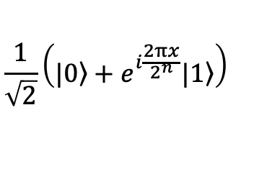



Implementation of DFT
DFT
$$|\left.x\right\rangle =|x_{1}x_{2}…\left.x_{n}\right\rangle$$
$$|\left.\overset{\sim }{x}\right\rangle =\frac{1}{\sqrt{2^{n}}}\left\lceil |\left.0\right\rangle +e^{i\frac{2πx}{2}}|\left.1\right\rangle \right\rceil ⊗\left\lceil |\left.0\right\rangle +e^{i\frac{2πx}{2^{4}}}|\left.1\right\rangle \right\rceil ⊗…\left\lceil |\left.0\right\rangle +e^{i\frac{2πx}{2^{n−1}}}|\left.1\right\rangle \right\rceil ⊗\left\lceil |\left.0\right\rangle +e^{i\frac{2πx}{2^{n}}}|\left.1\right\rangle \right\rceil$$
$$\frac{1}{\sqrt{2}}\left(|\left.0\right\rangle +e^{i\frac{2πx}{2^{n}}}|\left.1\right\rangle \right)$$
$$x_{n}$$
H
$$U_{2}$$
$$U_{n−1}$$
$$U_{n}$$
$$x_{n−1}$$
$$x_{2}$$
$$x_{1}$$

Slide 49






Implementation of DFT
DFT
$$|\left.x\right\rangle =|x_{1}x_{2}…\left.x_{n}\right\rangle$$
$$|\left.\overset{\sim }{x}\right\rangle =\frac{1}{\sqrt{2^{n}}}\left\lceil |\left.0\right\rangle +e^{i\frac{2πx}{2}}|\left.1\right\rangle \right\rceil ⊗\left\lceil |\left.0\right\rangle +e^{i\frac{2πx}{2^{4}}}|\left.1\right\rangle \right\rceil ⊗…\left\lceil |\left.0\right\rangle +e^{i\frac{2πx}{2^{n−1}}}|\left.1\right\rangle \right\rceil ⊗\left\lceil |\left.0\right\rangle +e^{i\frac{2πx}{2^{n}}}|\left.1\right\rangle \right\rceil$$
$$\frac{1}{\sqrt{2}}\left(|\left.0\right\rangle +e^{i\frac{2πx}{2^{n}}}|\left.1\right\rangle \right)$$
$$x_{n}$$
H
$$U_{2}$$
$$U_{n−1}$$
$$U_{n}$$
$$x_{n−1}$$
H
$$U_{2}$$
$$U_{n−2}$$
$$U_{n−1}$$
$$x_{n−2}$$
$$x_{2}$$
$$x_{1}$$

Slide 50
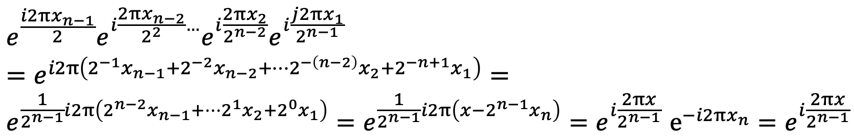
Implementation of DFT
$$e^{\frac{i2πx_{n−1}}{2}}e^{i\frac{2πx_{n−2}}{2^{2}}…}e^{i\frac{2πx_{2}}{2^{n−2}}}e^{i\frac{j2πx_{1}}{2^{n−1}}}$$
$$=e^{i2π\left(2^{−1}x_{n−1}+2^{−2}x_{n−2}+…2^{−\left(n−2\right)}x_{2}+2^{−n+1}x_{1}\right)}=$$
$$e^{\frac{1}{2^{n−1}}i2π\left(2^{n−2}x_{n−1}+…2^{1}x_{2}+2^{0}x_{1}\right)}=e^{\frac{1}{2^{n−1}}i2π\left(x−2^{n−1}x_{n}\right)}{=e}^{i\frac{2πx}{2^{n−1}}}e^{−i2πx_{n}}{=e}^{i\frac{2πx}{2^{n−1}}}$$
$$\frac{1}{\sqrt{2}}\left(|\left.0\right\rangle +e^{i\frac{2πx}{2^{n}}}|\left.1\right\rangle \right)$$
$$x_{n}$$
H
$$U_{2}$$
$$U_{n−1}$$
$$U_{n}$$
$$x_{n−1}$$
H
$$U_{2}$$
$$U_{n−2}$$
$$U_{n−1}$$
$$x_{n−2}$$
$$x_{2}$$
$$x_{1}$$

Slide 51

Implementation of DFT
$$e^{\frac{i2πx_{n−1}}{2}}e^{i\frac{2πx_{n−2}}{2^{2}}…}e^{i\frac{2πx_{2}}{2^{n−2}}}e^{i\frac{j2πx_{1}}{2^{n−1}}}$$
$$=e^{i2π\left(2^{−1}x_{n−1}+2^{−2}x_{n−2}+…2^{−\left(n−2\right)}x_{2}+2^{−n+1}x_{1}\right)}=$$
$$e^{\frac{1}{2^{n−1}}i2π\left(2^{n−2}x_{n−1}+…2^{1}x_{2}+2^{0}x_{1}\right)}=e^{\frac{1}{2^{n−1}}i2π\left(x−2^{n−1}x_{n}\right)}{=e}^{i\frac{2πx}{2^{n−1}}}e^{−i2πx_{n}}{=e}^{i\frac{2πx}{2^{n−1}}}$$
$$\frac{1}{\sqrt{2}}\left(|\left.0\right\rangle +e^{i\frac{2πx}{2^{n}}}|\left.1\right\rangle \right)$$
$$x_{n}$$
H
$$U_{2}$$
$$U_{n−1}$$
$$U_{n}$$
$$\frac{1}{\sqrt{2}}\left(|\left.0\right\rangle +e^{i\frac{2πx}{2^{n−1}}}|\left.1\right\rangle \right)$$
$$x_{n−1}$$
H
$$U_{2}$$
$$U_{n−2}$$
$$U_{n−1}$$
$$x_{n−2}$$
$$x_{2}$$
$$x_{1}$$

Slide 52

Implementation of DFT
DFT
$$|\left.x\right\rangle =|x_{1}x_{2}…\left.x_{n}\right\rangle$$
$$|\left.\overset{\sim }{x}\right\rangle =\frac{1}{\sqrt{2^{n}}}\left\lceil |\left.0\right\rangle +e^{i\frac{2πx}{2}}|\left.1\right\rangle \right\rceil ⊗\left\lceil |\left.0\right\rangle +e^{i\frac{2πx}{2^{4}}}|\left.1\right\rangle \right\rceil ⊗…\left\lceil |\left.0\right\rangle +e^{i\frac{2πx}{2^{n−1}}}|\left.1\right\rangle \right\rceil ⊗\left\lceil |\left.0\right\rangle +e^{i\frac{2πx}{2^{n}}}|\left.1\right\rangle \right\rceil$$
$$\frac{1}{\sqrt{2}}\left(|\left.0\right\rangle +e^{i\frac{2πx}{2^{n}}}|\left.1\right\rangle \right)$$
$$x_{n}$$
H
$$U_{2}$$
$$U_{n−1}$$
$$U_{n}$$
$$\frac{1}{\sqrt{2}}\left(|\left.0\right\rangle +e^{i\frac{2πx}{2^{n−1}}}|\left.1\right\rangle \right)$$
$$x_{n−1}$$
H
$$U_{2}$$
$$U_{n−2}$$
$$U_{n−1}$$
$$x_{n−2}$$
$$x_{2}$$
H
$$U_{2}$$
$$x_{1}$$
H

Slide 53












Approximate DFT
$$x_{n}$$
H
$$U_{2}$$
$$U_{n−1}$$
$$U_{n}$$
$$x_{n−1}$$
H
$$U_{2}$$
$$U_{n−2}$$
$$U_{n−1}$$
$$x_{n−2}$$
$$x_{2}$$
H
$$U_{2}$$
$$x_{1}$$
H
Only nearest neighbour coupling are reliable and others can be ignored, leading to approximate DFT

Slide 54



Inverse QFT
$$x[n]=x[n+N]=\frac{1}{\sqrt{N}}\sum_{k=−∞}^{∞}{a_{k}e^{ik\frac{2π}{N}n}}$$
$$a_{k}=\frac{1}{\sqrt{N}}\sum_{n=−∞}^{∞}{x[n]e^{−ik\frac{2π}{N}n}}$$
$$U_{k}=\left[\begin{matrix}1 & 0 \\ 0 & e^{−i\frac{2π}{2^{k}}}\end{matrix}\right]$$

Slide 55
Outline
General overview
Implementation of DFT
Quantum phase estimation

Slide 56

Quantum phase estimation
Problem statement: Given a unitary operator $U$ and an eigenvector $\left.|Ψ\right\rangle$ of the operator, estimate the corresponding eigenvalue?
For unitary operators,
$$U\left.|Ψ\right\rangle =E_{u}\left.|Ψ\right\rangle$$
$$\left\langle Ψ\left|U^{ϯ}U\right|\left.Ψ\right\rangle =\right.\left\langle Ψ\left|E_{u}^{ϯ}E_{u}\right|Ψ\right\rangle$$
$$\left\langle Ψ|\left.Ψ\right\rangle =\right.E_{u}^{ϯ}E_{u}\left\langle Ψ|Ψ\right\rangle$$
$E_{u}^{ϯ}E_{u}=1$ (Eigenvalues of the unitary operator lie on a circle).
$E_{u}=e^{iθ}$ (Thus, the question is can we estimate, $′θ′$?)

Slide 57



Quantum phase estimation
Problem statement: Given a unitary operator $U$ and an eigenvector $\left.|Ψ\right\rangle$ of the operator, estimate the corresponding eigenvalue?
$$|\left.Ψ\right\rangle$$
$$e^{iθ}|\left.Ψ\right\rangle$$
U
Any measurement is blind to global phase !

Slide 58




Quantum phase estimation
$$\frac{1}{\sqrt{2}}\left(|\left.0\right\rangle +|\left.1\right\rangle \right)$$
$$|\left.0\right\rangle$$
H
$$\frac{1}{\sqrt{2}}\left(|\left.Ψ\right\rangle ⊗|\left.0\right\rangle +e^{iθ}|\left.Ψ\right\rangle ⊗|\left.1\right\rangle \right)=$$
$$|\left.Ψ\right\rangle ⊗\frac{1}{\sqrt{2}}\left(|\left.0\right\rangle +e^{iθ}|\left.1\right\rangle \right)$$
$$|\left.Ψ\right\rangle$$
U

Slide 59



Quantum phase estimation
$$\frac{1}{\sqrt{2}}\left(|\left.0\right\rangle +|\left.1\right\rangle \right)$$
$$\frac{1}{\sqrt{2}}\left(|\left.0\right\rangle +e^{iθ}|\left.1\right\rangle \right)$$
$$|\left.0\right\rangle$$
H
$$|\left.Ψ\right\rangle$$
U
$$|\left.Ψ\right\rangle$$

Slide 60


Quantum phase estimation
$$\left\{\begin{aligned}0 ifθ=0 \\ 1 if θ=π\end{aligned}\right.$$
$$\frac{1}{\sqrt{2}}\left(|\left.0\right\rangle +e^{iθ}|\left.1\right\rangle \right)$$
H

Slide 61


Quantum phase estimation
$$\frac{1}{\sqrt{2}}\left(|\left.0\right\rangle +|\left.1\right\rangle \right)$$
$$\frac{1}{\sqrt{2}}\left(|\left.0\right\rangle +e^{i2θ}|\left.1\right\rangle \right)$$
$$|\left.0\right\rangle$$
H
$$|\left.Ψ\right\rangle$$
$$U^{2}$$
$$|\left.Ψ\right\rangle$$

Slide 62








How to make phase measurements more precise?
$$|\left.0\right\rangle$$
H
$$|\left.0\right\rangle$$
H
$$QFT^{−1}$$
$$|\left.0\right\rangle$$
H
$$|\left.Ψ\right\rangle$$
$$U^{2^{n−1}}$$
$$U^{2^{n−2}}$$
$$U^{2^{0}}$$

Slide 63



How to make phase measurements more precise?
$$\frac{1}{\sqrt{2}}\left(|\left.0\right\rangle +e^{iθ{(2}^{n−1})}|\left.1\right\rangle \right)$$
$$|\left.0\right\rangle$$
H
$$\frac{1}{\sqrt{2}}\left(|\left.0\right\rangle +e^{iθ{(2}^{n−2})}|\left.1\right\rangle \right)$$
$$|\left.0\right\rangle$$
H
$$QFT^{−1}$$
$$|\left.0\right\rangle$$
H
$$\frac{1}{\sqrt{2}}\left(|\left.0\right\rangle +e^{iθ}|\left.1\right\rangle \right)$$
$$|\left.Ψ\right\rangle$$
$$U^{2^{n−1}}$$
$$U^{2^{n−2}}$$
$$U^{2^{0}}$$

Slide 64

How to make phase measurements more precise?
$QFT^{−1}\left(\frac{1}{\sqrt{2}}\left(|\left.0\right\rangle +e^{iθ{(2}^{n−1})}|\left.1\right\rangle \right)⊗\frac{1}{\sqrt{2}}\left(\left|\left.0\right\rangle +e^{iθ{(2}^{n−2})}\right|\left.1\right\rangle \right)⊗…\frac{1}{\sqrt{2}}\left(|\left.0\right\rangle +e^{iθ}|\left.1\right\rangle \right)\right)=?$

Slide 65


How to make phase measurements more precise?
$QFT^{−1}\left(\frac{1}{\sqrt{2}}\left(|\left.0\right\rangle +e^{iθ{(2}^{n−1})}|\left.1\right\rangle \right)⊗\frac{1}{\sqrt{2}}\left(\left|\left.0\right\rangle +e^{iθ{(2}^{n−2})}\right|\left.1\right\rangle \right)⊗…\frac{1}{\sqrt{2}}\left(|\left.0\right\rangle +e^{iθ}|\left.1\right\rangle \right)\right)=?$
DFT
$$|\left.x\right\rangle =|x_{1}x_{2}…\left.x_{n}\right\rangle$$
$$|\left.\overset{\sim }{x}\right\rangle =\frac{1}{\sqrt{2^{n}}}\left\lceil |\left.0\right\rangle +e^{i\frac{2π(2^{n−1})x}{2^{n}}}|\left.1\right\rangle \right\rceil ⊗\left\lceil |\left.0\right\rangle +e^{i\frac{2π(2^{n−2})x}{2^{n}}}|\left.1\right\rangle \right\rceil ⊗…\left\lceil |\left.0\right\rangle +e^{i\frac{2πx}{2^{n}}}|\left.1\right\rangle \right\rceil$$

Slide 66

How to make phase measurements more precise?
$QFT^{−1}\left(\frac{1}{\sqrt{2}}\left(|\left.0\right\rangle +e^{iθ{(2}^{n−1})}|\left.1\right\rangle \right)⊗\frac{1}{\sqrt{2}}\left(\left|\left.0\right\rangle +e^{iθ{(2}^{n−2})}\right|\left.1\right\rangle \right)⊗…\frac{1}{\sqrt{2}}\left(|\left.0\right\rangle +e^{iθ}|\left.1\right\rangle \right)\right)=?$
DFT
$$|\left.x\right\rangle =|x_{1}x_{2}…\left.x_{n}\right\rangle$$
$$|\left.\overset{\sim }{x}\right\rangle =\frac{1}{\sqrt{2^{n}}}\left\lceil |\left.0\right\rangle +e^{i\frac{2π(2^{n−1})x}{2^{n}}}|\left.1\right\rangle \right\rceil ⊗\left\lceil |\left.0\right\rangle +e^{i\frac{2π(2^{n−2})x}{2^{n}}}|\left.1\right\rangle \right\rceil ⊗…\left\lceil |\left.0\right\rangle +e^{i\frac{2πx}{2^{n}}}|\left.1\right\rangle \right\rceil$$
$QFT^{−1}\left(\frac{1}{\sqrt{2}}\left(|\left.0\right\rangle +e^{iθ{(2}^{n−1})}|\left.1\right\rangle \right)⊗\frac{1}{\sqrt{2}}\left(\left|\left.0\right\rangle +e^{iθ{(2}^{n−2})}\right|\left.1\right\rangle \right)⊗…\frac{1}{\sqrt{2}}\left(|\left.0\right\rangle +e^{iθ}|\left.1\right\rangle \right)\right)=|x_{1}x_{2}…\left.x_{n}\right\rangle$
where decimal representation of $x_{1}x_{2}…x_{n}$ corresponds to $\frac{2^{n}θ}{2π}$

Slide 67
Application of QPE
Shor’s algorithm
In VQE based algorithms

Slide 68
Thanks for your attention &
Questions ?

